Slide 1
North West London Integrated Care System and Local Maternity System Equity and Equality strategy and action plan Summary report
NHS North West London (NWL) strives to ensure that every expectant mother’s experience, throughout their pregnancy and birth, recognises their individual needs. We are working together with our stakeholders, staff and the local community to understand those needs and developed a work plan that sets out how we will close the gap in known inequalities experienced by women* from Black, Asian and minority mixed ethnicity backgrounds.
February 2023
* Please note, within this report when we refer to a woman, women, mother or mum, we are including everyone regardless of gender identity.

Slide 2
Contents of this report
1.0 Introduction
1.1 Addressing NHS England’s five priorities
NW London’s population
2.0 Our local Maternity and Neonatal System
2.1 Our vison
2.2 Current work to support our communities
3.0 You said: ‘Engagement to understand maternity experience’
3.1 Talking with and listening to our communities and stakeholders
3.2 You said – key themes
4.0 We will: Action plan for improvements
4.1 We will – action plan overview
4.2 Priorities

Slide 3
1.0 Introduction
Addressing health inequalities is a core principle NHS North West London (NWL) is focussed on to improve the experiences and outcomes of all expectant parents.
Women from black, Asian and mixed ethnicity backgrounds are known to have more adverse outcomes than women from other backgrounds. The Covid-19 pandemic amplified these risks, and urgent action was taken by NHS England (NHS E) to recommend five priorities to protect expectant mums.
The pandemic evidenced that the NHS can change. The introduction of a screening tool to assess women’s individual risks throughout their pregnancy has increased clinical awareness of the risks to women from black, Asian and mixed ethnicity backgrounds. Online appointments and an increase in referrals to social prescribing enabled maternity services to continue in a way that kept expectant mother’s safe.
The pandemic also highlighted a need to review the ways in which we collect data and how that information is used to inform care that reflects the needs of our local population.
We know that 80% of the factors that impact health inequalities happen outside of healthcare services. Working together with our stakeholders the NWL NHS Integrated Care System and Local Maternity & Neonatal System (LMNS) we have developed a strategy that plans to close the gap in health inequality for women from black, Asian and mixed ethnicity backgrounds using maternity and neonatal services.
The NHS NW London Equity and Equality strategies intention is to create effective and sustainable improvement in how we work with our black, Asian and mixed minority ethnicity residents and staff. The report lays the foundation for future service development and puts listening, understanding and responding to service users at the heart of maternity care in NW London.

Slide 4
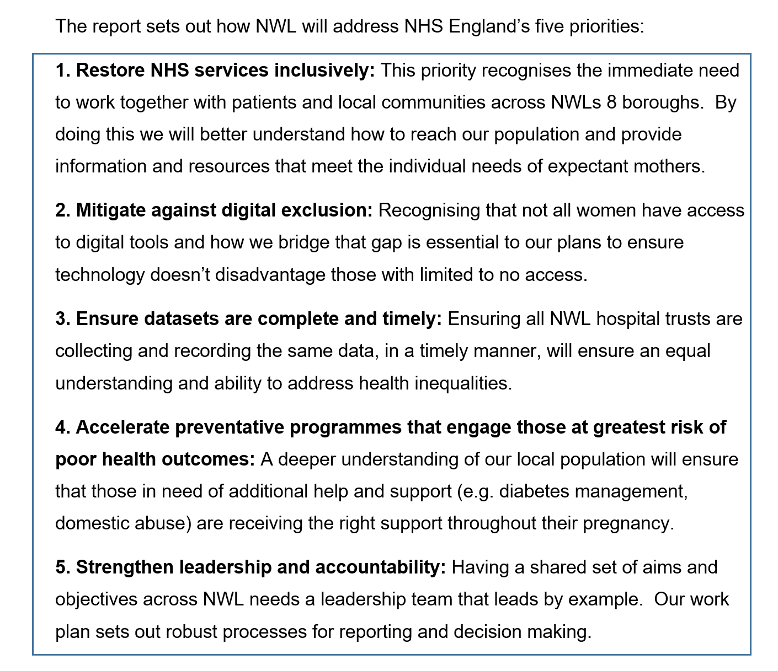
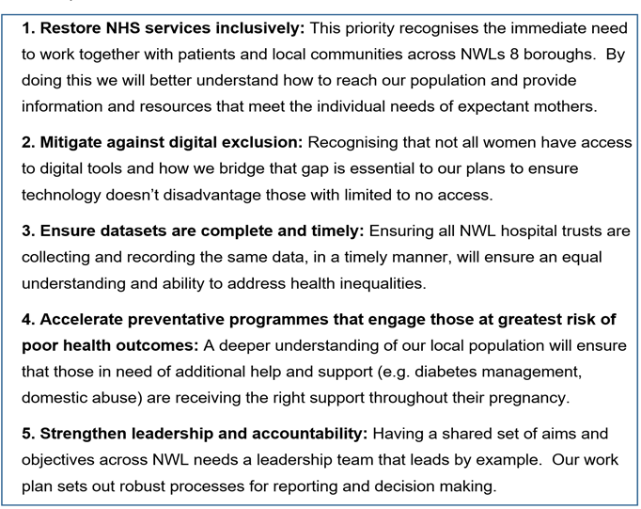
1.1 Addressing NHS England’s five priorities
The report sets out how NW London will address NHS England’s five priorities:

Slide 5
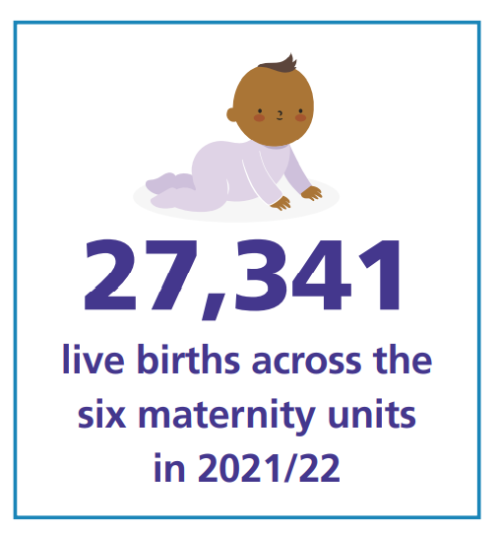
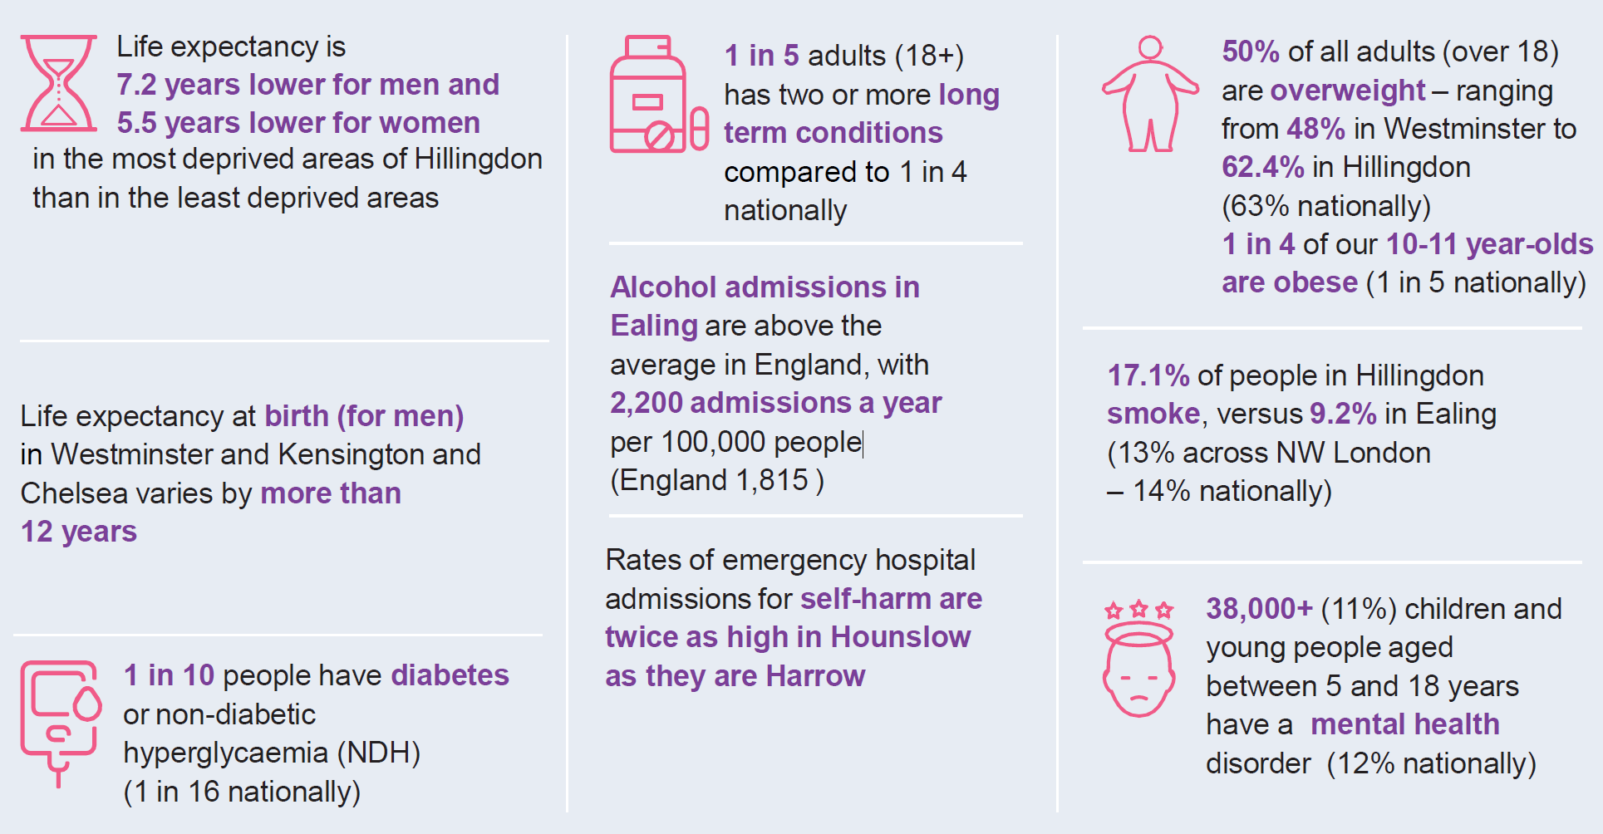
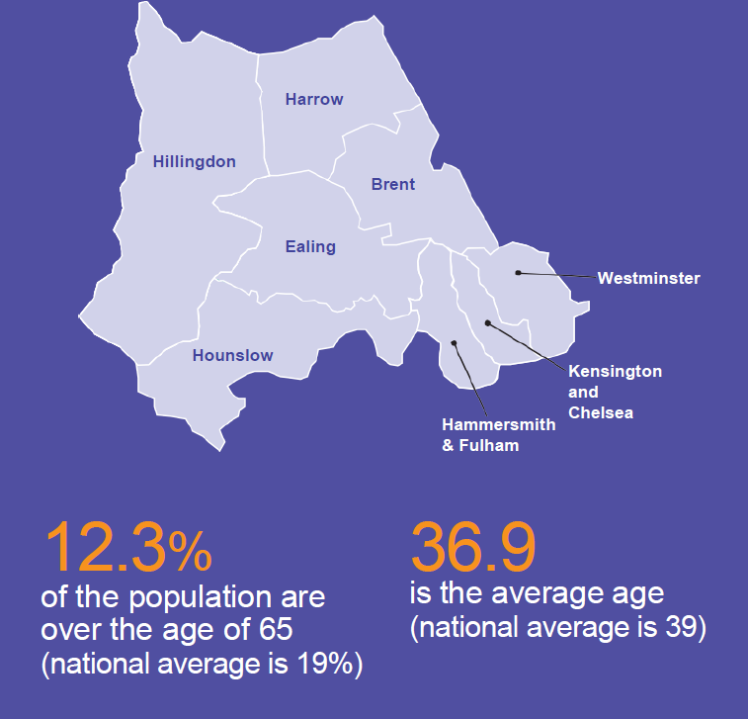
NW London is a diverse area with 2.4 million people from more than 200 ethnicities
Our residents belong to a number of different faiths including Christianity, Hinduism, Judaism, Islam and Sikhism
Work has been undertaken to improve data analysis to help us better understand our population’s health needs.

Slide 6
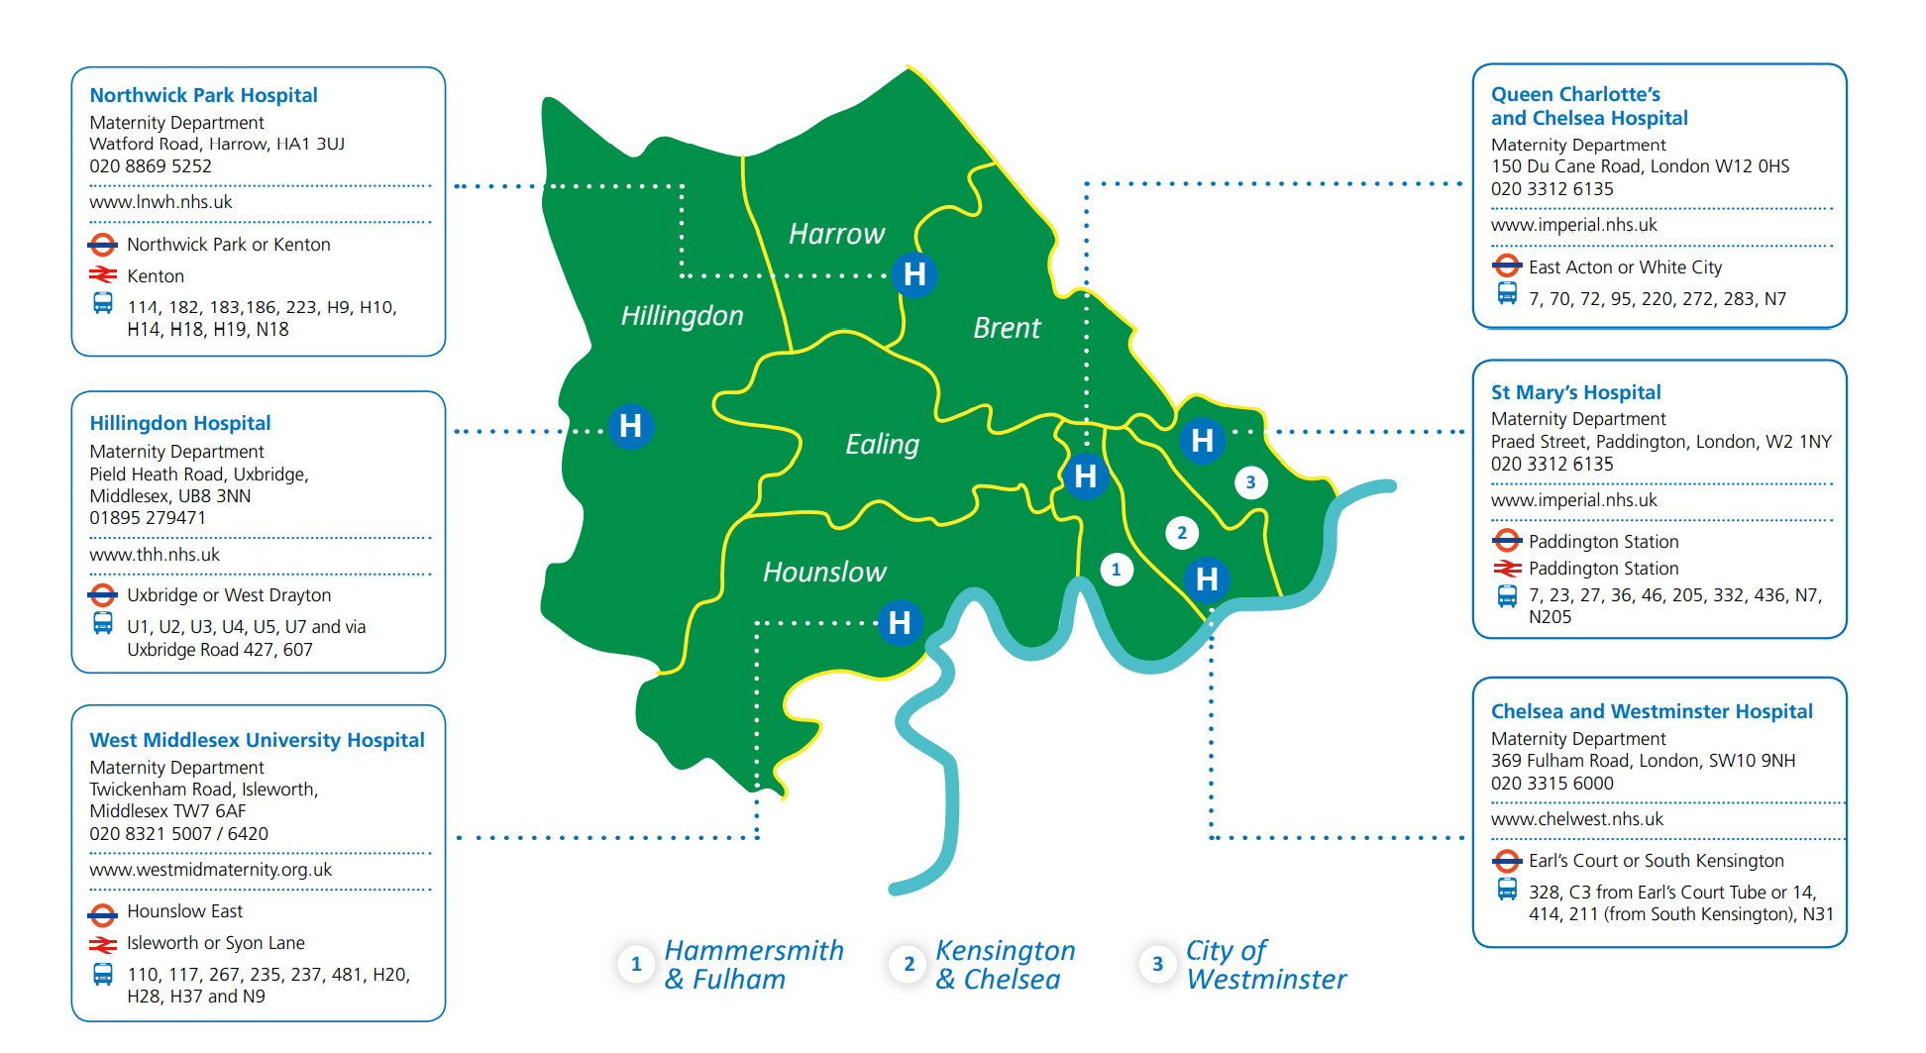
2.0 Our Local Maternity and Neonatal System
There are four acute hospital trusts that provide maternity and neonatal services in NW London, located across the system with six maternity units. The number of births at each unit varies between 3,000 and 5,700 per year. There are two level three neonatal units, three level two and one special care unit.

Slide 7
2.1 Our vision
NHS NW London is committed to growing a culture of mutual respect amongst its staff and communities. By listening to the voice of our service users, we have come to learn how we can provide a service that supports and nurtures expectant mothers from pregnancy to birth.
Addressing health inequalities is a core principle of the way we approach maternity service design and delivery across NW London.
All responses and actions require a system wide approach to ensure we improve health outcomes for our communities. We know that 80% of what impacts health inequalities are wider social determinants of health that happen outside of healthcare settings.
Developing this strategy has provided an opportunity to bring all stakeholders and networks together to ensure that the system is listening and responding to the inequality agenda. This is about creating demonstrable improvement in how we work with our residents.
Together, we will close the gap on health inequalities. We acknowledge that this will be a complex journey and to do it effectively will take time. Our strategy will be subject to iterative development and expansion as the needs of our population and staff evolve over time.

Slide 8
2.2 Current work to support our communities
There is currently lots of work, projects and practices taking place across NW London to support our communities, including; women and pregnant people from B black, Asian and mixed ethnicity backgrounds and those living in areas of deprivation, to help reduce health inequalities.
Further information on all the areas below can be read in the full report, pages 14-16.
Reduced fetal movement videos
Healthy pregnancy infographic
Meet the midwife virtual events
Supportive signposting
NW London post-birth contraceptive service
Managed quarantine services
Afghan evacuee response

Slide 9
3.0 You said ‘Engagement to understand maternity experience’

Slide 10
3.1 Talking with our communities and stakeholders
We are utilising NW London business intelligence data to enable targeting of community groups and service users, to establish factors such as deprivation decile, mothers ethnic category and those with complex social factors which may impact maternal or fetal outcomes.
Working with different NHS teams, including; safeguarding, GP partners, Core 20 plus 5, A&E, NHS 111, diabetes and children and young people teams to gain insight on maternity overlaps and challenges.
By creating a comprehensive database of NW London contacts we are categorically working to reach maternity service users to share information including with community centres, children’s and family wellbeing hubs, GPs, pharmacies, foodbanks, libraries and voluntary care sector organisations.
Hearing from service users
NW London ICB facilitates a weekly maternity feedback forum where service users have an opportunity to share their experiences, thoughts and/or suggestions on how services could be improved. Providing a safe space for all service users past and present, to gain insight into the work that is taking place to make improvements; with a spotlight on equity and equality.
Maternity focused engagement colleagues and wider teams attend events across the eight NW London boroughs, prioritising where there have been gaps in engagement with maternity service users from those whom are not often in contact to share their views. This includes individuals and groups from ethnic minority backgrounds and with others where barriers may have previously hindered access to sharing experience. We aim to understand the barriers and challenges to achieving this goal and address it where possible adapting the approach or resources required for successful engagement.
Going forward into the new financial year we aim to share a maternity survey aligned to CQC survey and other insights to provide an additional method of feedback for service users to share their experience with maternity services in NW London.
Widen service user participation in maternity service redesign through Maternity Voice Partnership, ensuring participation is representative of NW London demographic. Working on understanding barriers and challenges faced by MVPs to engagement with service users.

Slide 11
3.2 You said – key themes
With feedback collated from interviews, focus groups and community insight, key themes have been identified to highlight pregnant women’s experiences of their maternity journey. Below we outline an overview of what our communities have shared. It is clear that some difficult experiences and poor outcomes could have been different by providing accessible information, increased communication and greater cultural awareness from health care professionals.
Staffing availability within hospitals during antenatal and postnatal period.
Staffing pressures impacting communication.
Parents and parents to be from ethnic minority backgrounds feel underserved.
Postnatal breastfeeding support affecting initiation and establishment.
Access to information in services users first language.
Staff/healthcare professionals unfamiliar with beliefs, practices and traditions surrounding pregnancy and postnatal period from alternate cultures.
Equality in information provided to service users during appointments.

Slide 12
4.0 We will - action plan for improvements

Slide 13
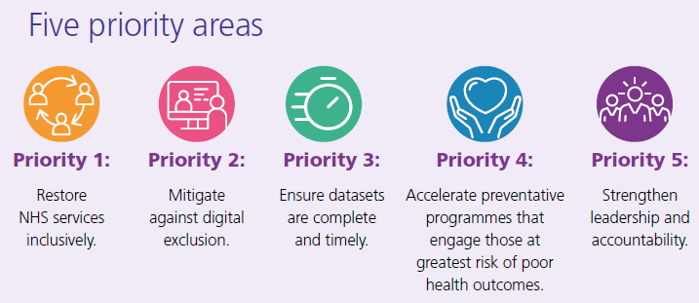
4.1 We will – action plan overview
The production of this document enables the LMS and ICS to conceptualise our baseline position for maternity services in 2022.
The report tells us both what we do know and what steps we need to take to discover more.
It clearly outlines where gaps are present and states what directive action will be taken to address the gaps that will enable us to make inroads on reducing inequalities and inequity in maternity services.
This is only the beginning of our journey, and the strategy will develop as the vision matures.

Slide 14
4.2 Priorities - 1 & 2
Priority 1: Restore NHS services inclusively
Focus | Actions | Measure | Timeline
Continue to implement the Covid-19 four actions | Fully embed the Covid-19 screening tool both the antenatal and postnatal elements at all units Audit Covid-19 screening tool for effectiveness Evaluate impact of tailored communications – healthy pregnancy poster, reduced fetal movement videos Evaluate impact of routine vitamin D testing for all pregnant women at LNWUHT In collaboration with Primary Care and Medicine Management develop standardised NW London agreement for testing and treatment of vitamin D deficiency in pregnancy Work with providers to improved capture of ethnicity and derivation status and reporting on maternity IT systems | Covid-19 tool adapted to be embedded as routine clinical practice Audit and surveys | Business as usual March 20204
Priority 2: Mitigate against digital exclusion
Focus | Actions | Measure | Timeline
Ensure personalised care and support plans (PCSPs) are available in a range of languages and formats | Identify maternity service users facing potential digital exclusion areas and provide the necessary support to facilitate best use of digital tools and systems Share digital inclusion resources for front-line staff to signpost residents to digital solutions in their local areas Develop and implement a digital champion model | KPI metrics audit | March 2024

Slide 15
4.2 Priority area - 3
Priority 3: Ensure datasets are complete and timely
Focus | Actions | Measure | Timeline
On maternity information systems continuously improve the data quality of ethnic coding and the mother’s postcode | Develop and submit NW London Maternity Digital Strategy Enhance MSDS submission and the accuracy of the data by implementing a new process prior the final submission Upgrade maternity IT systems Regular data quality checks via LMS digital meeting To capture data on MCoC teams, deprivation and ethnicity. Monitor quality and progress with monthly dashboard check and MSDS submissions | Strategy approved by ICB in January 23 Use of What Good looks like framework to RAG rate the LMNS trusts system and monitor progress Quarterly analysis Task and finish groups to r/v metrics | Business as usual End of April 2023

Slide 16
4.2 Priority 4: Accelerate preventative programmes that engage those at greatest risk of poor health outcomes 1/5
4.a: Understand your population and co-produce interventions
Focus | Actions | Measure | Timeline
Understand the local population’s maternal and perinatal determinants of health) | Build population health dashboards to provide a picture of change over time Investment in resource to facilitate easy extraction of data from maternity information systems is needed Retrieve, clean and analyse maternity information system data sets to get a better overview of maternity outcomes by ethnicity and deprivation To analyse provider process indicators and outcomes by ethnicity to ensure that resources are proportionally directed across the system to areas of highest acuity by ethnicity LMS to work collaboratively with borough based partners to share, understand data and to better understand the correlation between maternity outcomes and social determinants of health | Dashboard quarterly analysis | Business as usual

Slide 17
4.2 Priority 4: Accelerate preventative programmes that engage those at greatest risk of poor health outcomes 2 /5
4.a: Accelerate preventative programmes that engage those at greatest risk of poor health outcomes
Focus | Actions | Measure | Timeline
Map the community assets which help address the social determinants of health | Mum & Baby App: Complete full app translation into Romanian, Guajarati, Hindi, Arabic and Somali Pilot integration with Care Information Exchange Increased promotion of and awareness of Mum & Baby app content and functionality Supportive Signposting: Work with the ICS partners to establish future SSP sustainability and standardisation Recommence in-depth data collection and collation on ethnicity of users of the SSP service and to include deprivation data Maternity Champions & Voluntary sector services: Explore expansion of maternity champions programme to outer 5 boroughs Increase collaboration with maternity champions and wider voluntary sector Domestic abuse services/charities: enhanced engagement to ensure resources are available for distribution to the pregnant and postnatal populations they serve Work collaboratively with people having lived experience to design services/clinics that meet all cultural and diverse needs Religious groups: MTP engagement lead to develop sustainable communication methods to share information between service providers and users, build trust and collaboration in future maternity service design Children’s centres and family hubs: MTP engagement lead develop communications methods to share information between sectors. This will allow maternity services to work with teams to have more understanding of the needs of the services users, reasons that for reluctance to engage with some health interventions and also extends the reach of information that needs to be disseminate to pregnant and postnatal pregnant people and their families | Availability of translation in different languages in the App Equity Health Impact assessment Record of engagement activities | Sept 2024 (on hold to align with implementation of Cerner sector-wide) 2024 2025 Business as usual

Slide 18
4.2 Priority 4: Accelerate preventative programmes that engage those at greatest risk of poor health outcomes 3 /5
Focus | Actions | Measure | Timeline
Conduct a baseline assessment of the experience of maternity and neonatal staff by ethnicity using WRES indicators 1 to 8 | Ensure that training is rolled out for staff to increase awareness of diversity and inclusion issues Reviews of organisational/departmental culture potentially impacting diversity Recruitment of cultural safety champions (with protected time to fulfil the role) Strengthen diversity and inclusion through ensuring that there is ethnic minority representation in all recruitment selection process, at interviews and working as part of the team to improve staff experience Adoption of the Capital Midwives Civility Toolkit Access to detailed localised data to help the LMNS to understand what is taking place in each maternity unit and thus enable the LMNS to develop an action plan to mitigate the existing challenges and make a positive impact before the next round of survey, with an aim for year on year improvement Develop a WRES action plan to improve the experience of the staff and system partners | Monthly MDT dashboard training reviewing Capital midwives civility toolkit action plan completion Capital midwives accreditation programme WRES Action plan | Business as usual

Slide 19
4.2 Priority 4: Accelerate preventative programmes that engage those at greatest risk of poor health outcomes 4 /5
Focus | Actions | Measure | Timeline
Set out a plan to co- produce interventions to improve equity for mothers, babies and race equality for staff | Work in partnership across the ICS to reach out into the community and hear the views of our people Targeted engagement focusing on MCoC, MMN, FM, AIP, Pre-term birth & smoke free pregnancy Support development of ICS strategy and population health and care inequalities strategy by ensuring public involvement in ICS/ICP decision-making Working with local authorities to develop a coordinated programme of outreach and community research in our population in each borough, using population health and outcomes data, as well as existing grassroots community knowledge, to target specific communities as appropriate Holding a weekly Public Maternity Engagement Feedback Forum where residents and current or past service users can share experiences and suggestions about Maternity Services in North West London and hear more about the work going on to improve equity and equality Holding quarterly ‘collaborative spaces’ in each borough: open community conversations where health and care professionals come together with the public and stakeholders to discuss healthcare issues. The agenda for these meetings will be co-designed with residents; it is important to recognise that issues raised unprompted by local people can provide important insights. (These conversations may be combined with existing arrangements at borough level where appropriate) Enabling easy and accessible feedback from the public through an online survey in the form of a questionnaire about local Maternity services. With resulting data to be analysed monthly and shared at Maternity Transformation meetings and suggestions for improvements to be transparent to all trusts Begin engagement with the workforce to share feedback on their staff experience within the maternity sector and share insight in Maternity transformation meetings to enable opportunity to develop strategies for a more satisfied and engaged workforce. Working on building increased support for mental health and wellbeing and enable a more supportive, inclusive and diverse work environment at all levels ICB to publish monthly insight reports setting out what we are hearing from our residents Ensuring that residents are represented and supported to participate equally on key ICS and borough-based work streams so that there are always a resident/patient voices in the room. Build on the success of the Imperial lay partner programme by sharing learning across the system Working with public health directors to deliver integrated public health campaigns on agreed topics Specifically target and work with groups with specific needs, including people with long term conditions, black and minority ethnic communities, people with disabilities including people with learning difficulties and autism, traveller communities, children and young people, older people, mental health service users, LGBT communities, family carers and others. This work will be carried out at borough level, based on local health data and insights Ensuring NHS service change programmes and key ICS and borough-based work streams carry out appropriate public involvement or consultation – this work can be led at Trust, provider collaborative or ICS level as appropriate Ensuring that our duties under equalities legislation are met and exceeded by putting in place ICB oversight of equalities impact assessments, conducting appropriate gap analyses of which communities and groups we talk to | Record of engagement activities Survey | Business as usual

Slide 20
4.2 Priority 4: Accelerate preventative programmes that engage those at greatest risk of poor health outcomes 5 /5
Focus | Actions | Measure | Timeline
Set out a plan to co produce interventions to improve equity for mothers, babies and race equality for staff | Recognising digital exclusion by ensuring a good mix of in-person and online engagement with people and communities Use our 3,800-strong, demographically representative Citizens’ Panel to deliver surveys and focus group research across the ICS and to disseminate healthcare information Developing and maintaining a strong focus on hearing from people who are furthest from decision making by working with grassroots community organisations, charities, churches, employers, schools, patient groups, MPs and councillors, Health watch and residents’ associations to maximise our reach in to local populations Coordinating social media activity across the sector, especially on maternity public health campaigns, service change programmes and promoting public events and involvement opportunities. We will use a multi-channel approach, including film and infographics, to get information across Continuing to work proactively and reactively with the media so that we can communicate important messages to local people and other stakeholders Developing our single website housing ICB and ICS content and this site will link to all partner organisations’ websites. Which incorporates information about maternity This is a three-year strategy, which will be iterated depending on insights and developments in year one. Year two and three objectives will build on year one, with specific objectives to be added depending on insights received, specific ICS/ICB programmes and population health and care metrics | Record of engagement activities Increased social media presence | Business as usual

Slide 21
4.2 Priority 4b: Action on perinatal mortality and morbidity 1/3
Focus | Actions | Measure | Timeline
Implement maternal medicine networks to help achieve equity | Engage with service users, clinicians and allied healthcare in the region to inform, educate and support their understanding and referral to any of the services of the MMN Co-produce leaflets, posters and information with MVP to share within region Review and strengthen online consultations to reduce unnecessary travel for women in the region Complete ITU admissions audit including ethnicity and deprivation and present to regional and London region Complete maternal death audit for the last 3 years, including ethnicity and deprivation data Ensure that audit gathering is completed and submitted from each trust including ethnicity and deprivation data Review stillbirth and NND monthly including ethnicity and deprivation data Continue regular training and education programs in conjunction with the London networks Update all Trust websites with information on maternal medicine networks for women Provide education on maternal medical conditions to all clinicians including primary care, and any other health professional who may encounter women who have medical conditions and are of childbearing age Map fetal medicine services across the region Establish fetal medicine subspecialist in each hospital in the region Establish maternity voices partnership presence for each services to co-produce services and information for women and birthing people Agree London Ambulance transfer pathway for AIP Develop agreed key performance indicators Collect ethnicity and deprivation data on all women referred to fetal medicine and AIP services | Record of engagement activities Audits Surveys KPIs | Business as usual
Focus | Actions | Measure | Timeline
Offer referral to the NHS Diabetes Prevention Programme to women with a past diagnosis of gestational diabetes mellitus (GDM) who are not currently regnant and do not currently have diabetes | By April 2023, there will be pathways in place to refer women who have been diagnosed with gestational diabetes to the NHS DPP services Quarterly reports to the LMNS on how many women with protected characteristics are referred to the service for follow up and whether they attended All women who meet criteria for gestational diabetes screening according to NICE guidance are screened at the recommended gestations by April 2024 in all hospital trusts in the region | Audits | Business as usual

Slide 22
4.2 Priority 4b: Action on perinatal mortality and morbidity 2/3
Focus | Actions | Measure | Timeline
Implement NICE CG110 antenatal care for pregnant women with complex social factors | Establish maternity safeguarding clinical reference group Scope and analyse the range of complex social information available from ICS data sets Develop key process and performance indicators to establish the impact of social complexities on pregnancy and birth outcome | Quarterly analysis | 2024-25
Focus | Actions | Measure | Timeline
Implement maternal mental health services with a focus on access by ethnicity and deprivation | To improve data quality across the MMHS service including ethnicity and IMD To re-evaluate the service in April 2023 To develop a programme of mini audits for the service To promote to GPs and wider primary and community services To further develop relationships with community organisations – accessing representative population | Audits Surveys and audits | June 2023 Business as usual
Focus | Actions | Measure | Timeline
Ensure personalised care and support plans are available to everyone | LMS level audit of PCSP uptake at all maternity units as per national guidance PCSP implementation evaluation, including deprivation and ethnicity breakdown on PCSP usage Via the audit, evaluate the quality of personalised discussions We will work with the business intelligence and digital teams to improve data quality and MSDS submissions as well as upgrade our infrastructure and information systems in maternity Review and continue monitoring the PCSP engagement and communication strategy Devise a method to monitor PCI training compliance Create a strategy for further incorporating the motivational interviewing approach into healthcare consultations Explore and consider participation in the London regional personalised care working groups The enhanced MCoC teams will aid in the implementation of PCPs for black, Asian, and mixed ethnic groups, as well as those living in low income areas | Audits Quarterly analysis Yearly auditing | 2024-25
Notes:
Strategy approved by ICB in January 23
Use of What Good looks like framework to RAG rate the LMNS Trusts system and monitor progress
Quarterly analysis
Task and finish groups to r/v metrics

Slide 23
4.2 Priority 4b: Action on perinatal mortality and morbidity 3/3
Focus | Actions | Measure | Timeline
Ensure the MVPs in your LMS reflect the ethnic diversity of the local population, in line with NICE QS167 | A strategy to create a more robust and accessible system for MVP involvement and more diverse service user representation across NW London is being designed Formative plans are in evolution where, alongside MVPs, a newly established network will be created with regular contact and further involvement of local systems and people | Benchmark against National MVP Toolkit | March 2024
Focus | Actions | Measure | Timeline
Establish a perinatal pelvic health service | Work towards national KPI’s related to service Service evaluation including birthing people’s experience of PPHS Provide education for staff on the service and pathways of care | KPI, surveys | Business as usual

Slide 24
4.2 Priority 4c: Action on perinatal mortality and morbidity 1/2
Focus | Actions | Measure | Timeline
Implement targeted and enhanced continuity of carer, as set out in the NHS Long Term Plan. This means that, as continuity of carer is rolled out to most women, women from black, Asian and mixed ethnic groups and women living in deprived areas are prioritised, with 75% of women in these groups receiving continuity of carer by 2024. It also means ensuring that additional midwifery time is available to support women from the most deprived areas | NWL LMNS works collaboratively with system partners to have a clear strategy for the implementation of MCoC. The action plan has several recommendations Targeted staff and service user engagement strategy including staff workshops and open forums focusing on the building blocks Work closely with MVPs and service users in engaging the hard to reach groups of population and promote co production ICS review of estates, to ensure that procurement of estates for provision of maternity services in community locations is fair and equitable across the system. With hubs located in areas of greatest need Coaching training will continue for second year aiming to receive train the trainer sessions to gain sector wider trainer to cascade the training in future. We also aim to implement the principles and create a new culture across the sectors We are also planning a further analysis of the MCoC audit is planned to take place by the end of the year in order to evaluate the service for 2019-21 Upgrade the infrastructure and the information systems to improve use in the community 177 | MCoC National action plan record of engagement activities Surveys | 2024

Slide 25
4.2 Priority 4c: Action on perinatal mortality and morbidity 2/2
Objective: Action on perinatal mortality and morbidity
Focus | Actions | Measure | Timeline
Implement a smoke-free pregnancy pathway for mothers and their partners | Agreed sector wide guideline for tobacco cessation services for service users of maternity services and acute providers Establish in house tobacco cessation services that work collaborative across services/specialities/ departments developing system wide referral pathways Create and cement referral links between acute/ maternity providers and local authority lead tobacco cessation services to ensure babies are discharged to smoke free homes Aid transformative options to facilitate data collection with ease to monitor the KPIs set out by MatNeoSIP, Long Term Plan, SBLv2 and those that are agreed at the NW London ICB Tobacco steering group including ethnicity and IMD of smokers Improve data collection on white other ethnic groups | Metrics | 2024-25
Implement an LMS breastfeeding strategy and continuously improve breastfeeding rates for women living in the most deprived areas | Gap analysis will be undertaken to establish quality, quantity and consistency of infant feeding support across the sector, ensuring that no population or community is without access to infant feeding support in either acute or community settings Develop ICS strategy for infant feeding Strategy implementation |  | 2024-25
Culturally-sensitive genetics services for consanguineous couples. | Collect ethnicity and IMD data For those who use NW London genetic services Establish a working group to run a campaign across NW London, include service users and a wide range of primary health care clinicians Co-produce information with service users from communities affected | KPI Engagement | 2024-25

Slide 26
4.2 Priority 4d: Action on perinatal mortality and morbidity
Objective: Action on perinatal mortality and morbidity
Focus | Actions | Measure | Timeline
Roll out multidisciplinary training about cultural competence in maternity and neonatal services | Recruit dedicated cultural safety champions in each maternity unit Integrate cultural safety standards collaboratively with the neonatal colleagues All maternity units cultural safety champions and senior managers to attend bespoke training Roll out cultural safety training to all staff during mandatory education study days LMS Cultural safety group to monitor, develop and provide assurance to LMS board of the implementation of LMS equality and equity strategy | Cultural safety leads in post Training evaluation/surveys | Sept 2023 2024
When investigating serious incidents, consider the impact of culture, ethnicity and language | Improve capture /reporting of ethnicity, language and IDM Prioritise and monitor plans/ implementation of QI projects arising from SI Spreadsheet of serious incidents to collate themes including data on ethnicity and IDM Conduct annual thematic analysis of serious incidents themes from across the sector | Surveys, thematic analysis report | Business as usual
Implement the Workforce Race Equality Standard (WRES) in maternity and neonatal services | Providers to Implement ambitions for indicators 1-8 stated in the ICB WRES action plan LMS to monitor progress, challenge and provide assurance towards achieving ambitions stated in the ICB WRES action plan | WRES Action plan complete | March 2024

Slide 27
4.2 Priority 4e: Enablers
Focus | Actions | Measure | Timeline
Establish community hubs in the areas with the greatest maternal and perinatal health needs | ICS level mapping of all community estates, with agreed solutions to support the expansion of MCoC services in communities |  | 2024-25
Work with system partners and the VCSE sector to address the social determinants of health | Ensure that there is open communication amongst partners and to provide an avenue for any citizen to communicate with the maternity arm of the ICB and the wider ICB Ensure there is pregnancy and birth information and education accessible to all Ensure services are accessible to all regardless of language barriers and location Ensure to take into account the people and culture of the population we work with and support Build trust between the residents in the population and the health services. Taking into account different avenues that reach the population including religious organisations, community groups and leaders and/ or changing mind-sets by addressing barriers or preconceived ideas in both population and health care professionals Ensure we can include our local communities into planning process of services |  | 2024-25

Slide 28
4.2 Priority 5: Strengthen leadership and accountability
Focus | Actions | Measure | Timeline
 | Contribute to developing the NW London ICS strategy Complete outstanding actions on the LMNS capabilities and capacity framework Strengthen relationships with all ICS stakeholders in maternity and neonatal service |  | 2024-25

