Slide 1
Lichfield Radio Observatory (LRO)
Beginners Guide
Hydrogen Line
Radio interferometry
Dr Andrew Thornett,
M6THO www.astronomy.me.uk
ALMA Interferometer

Slide 2
Lichfield Interferometer Radio Array (LIRA)
5m separation which is about maximum
For my garden

Slide 3
What is interferometry
An astronomical interferometer consists of two or more separate telescopes that combine their signals, offering a resolution equivalent to that of a telescope of diameter equal to the largest separation between its individual elements

Slide 4
Famous radio interferometers
Very large baseline array. Ten observing stations located across the United States. Each station consists of a 25-meter radio antenna dish.
E-Merlin. Seven radio telescopes spanning 217 km across Great Britain connected by a superfast optical fibre network to its headquarters at Jodrell Bank Observatory.
Square Kilometer Array. Australia and South Africa.
Event Horizon Telescope. Across the world – imaging black holes M87 and Milky Way.

Slide 5
Principles of interferometry

Slide 9
Ryle and Vonberg Interferometer

Slide 10
What objects can you observe?
Point sources not extended objects
Sun
Cassiopeia A - supernova remnant
Cygnus A - radio galaxy
Hercules A (3c348) - supergiant eliptical galaxy
3c392 - active galactic nucleus

Slide 11
What aerials can be used

Slide 12
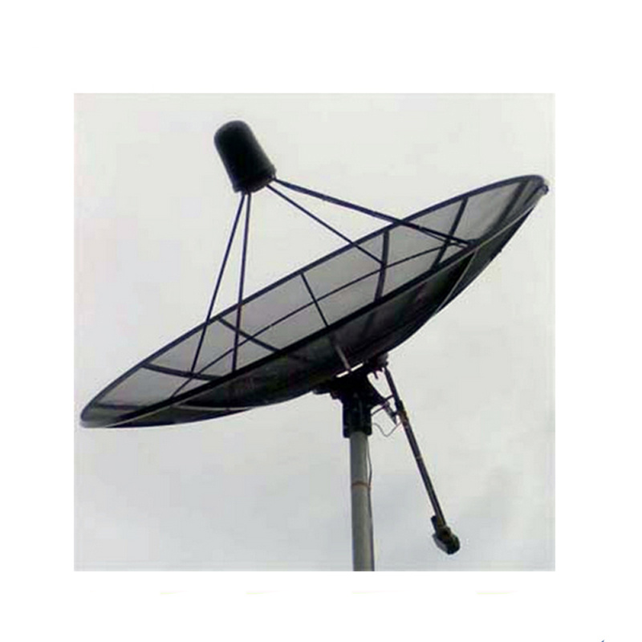
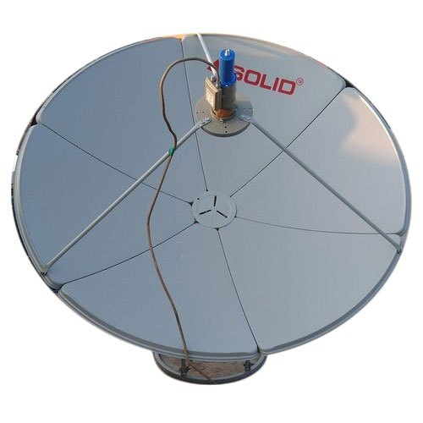
Everyone wants a 3m dish or two…
3m dishes come with mounting problems…

Slide 13
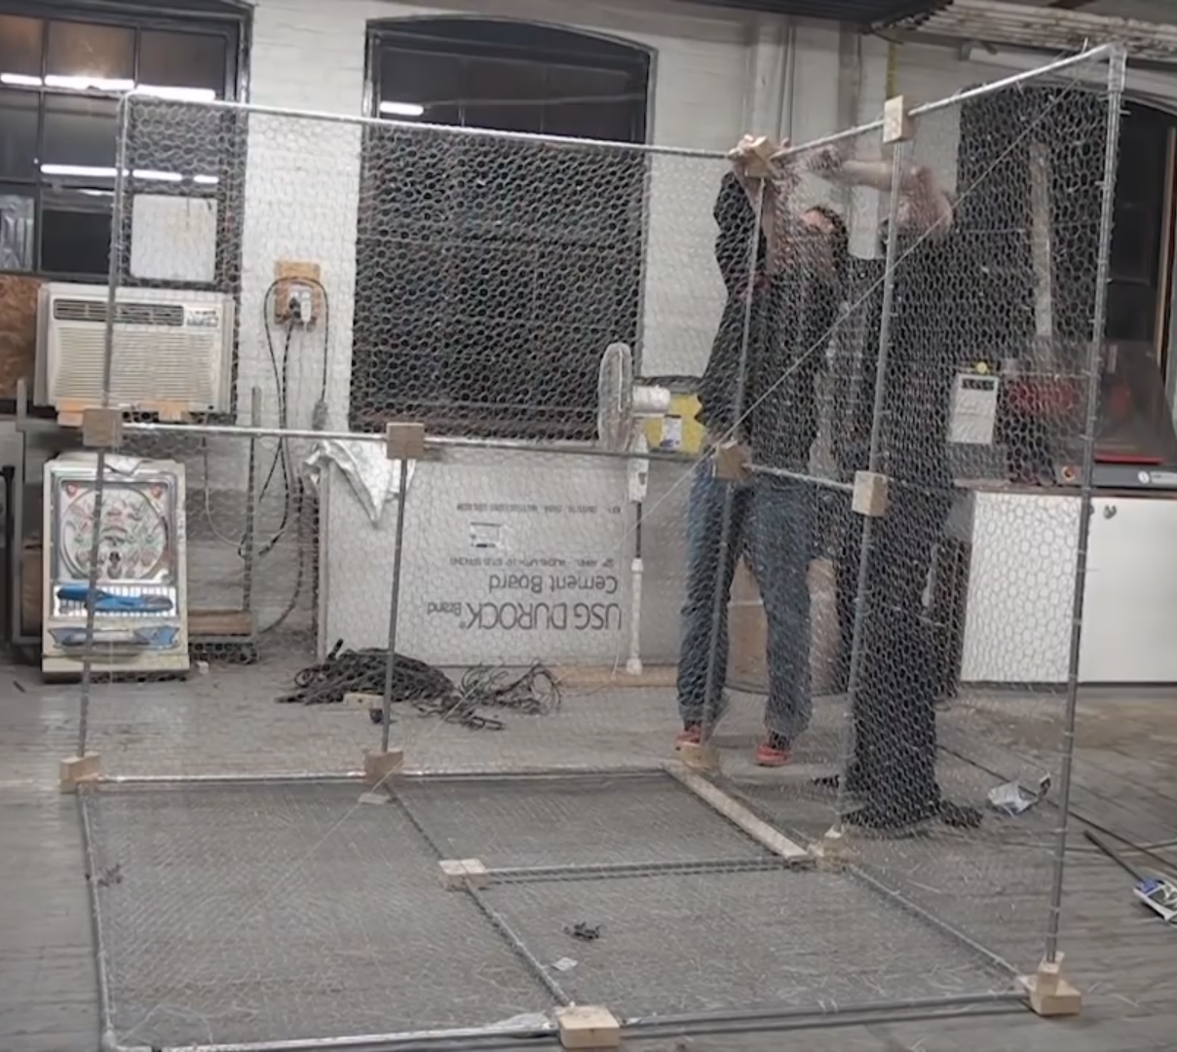
Corner aerials from chicken wire
..Easy to build but not easy to move & not beautiful!
Very big corner aerial

Slide 14
Helical Aerials

Slide 15
Photo/Diagram by Ted Cline

Slide 16
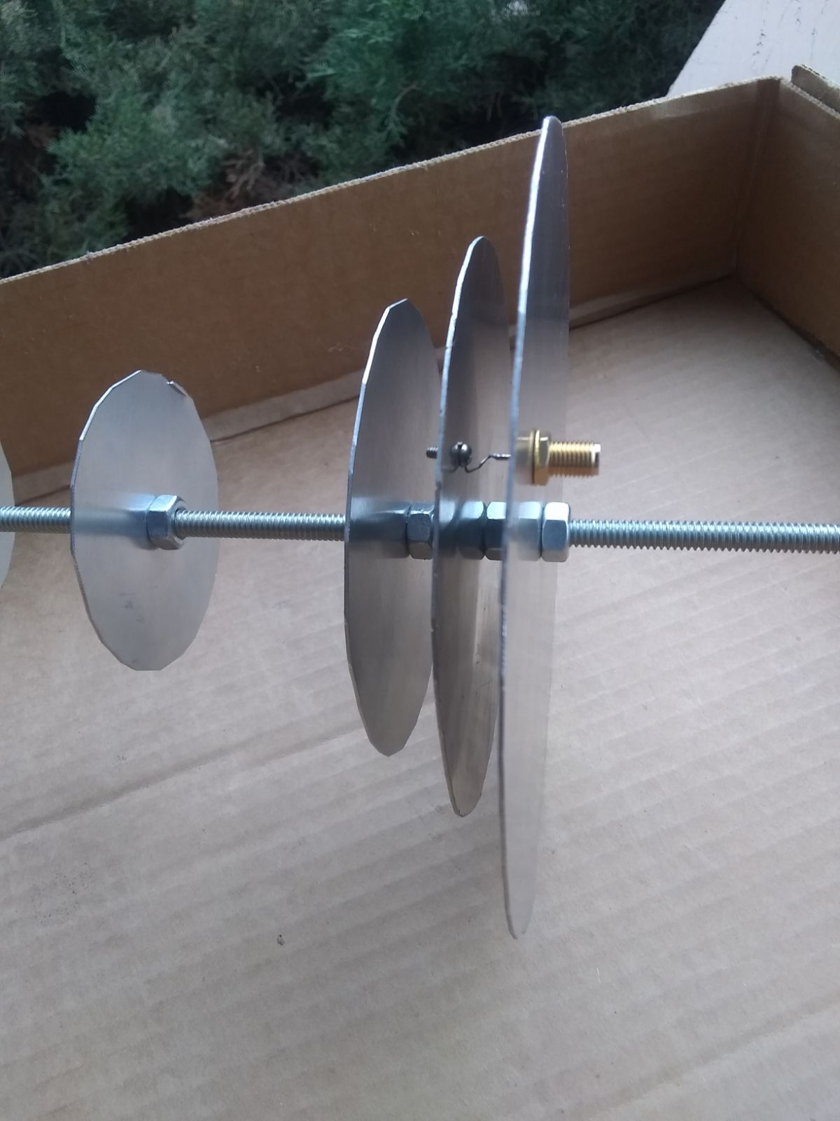
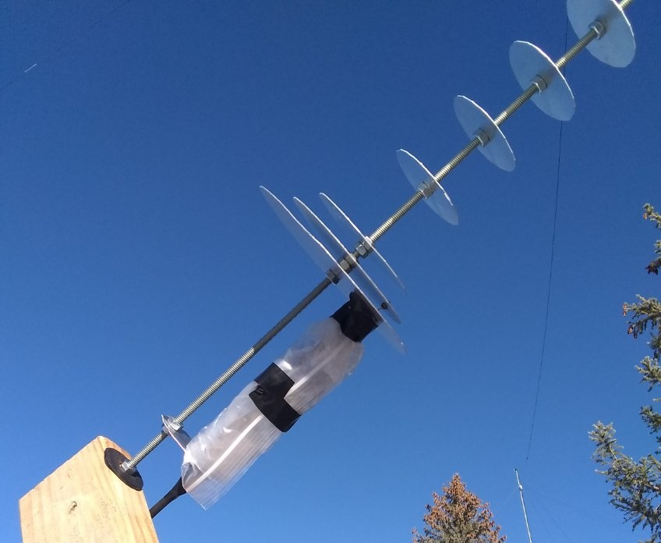
Easy Disc Yagi Aerial

Slide 17
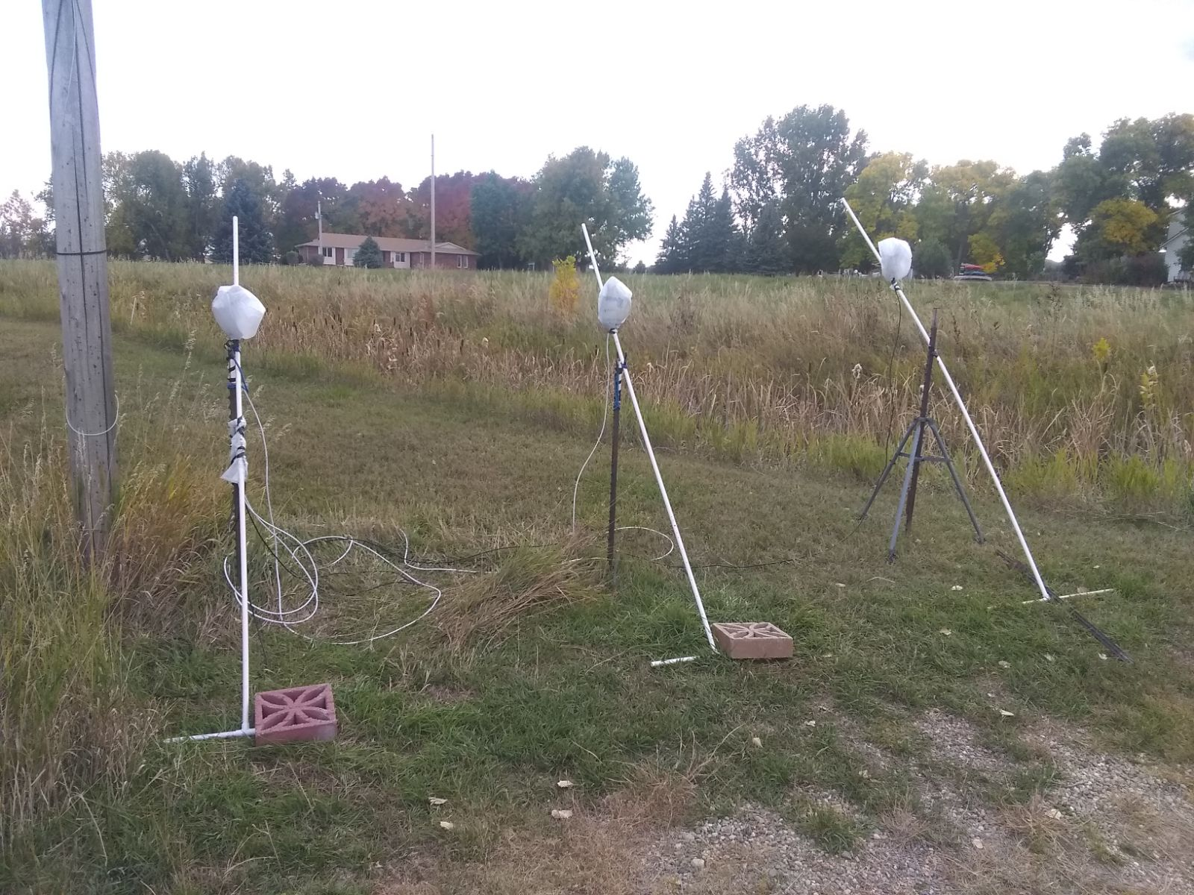
Photo/Diagram by Ted Cline

Slide 18
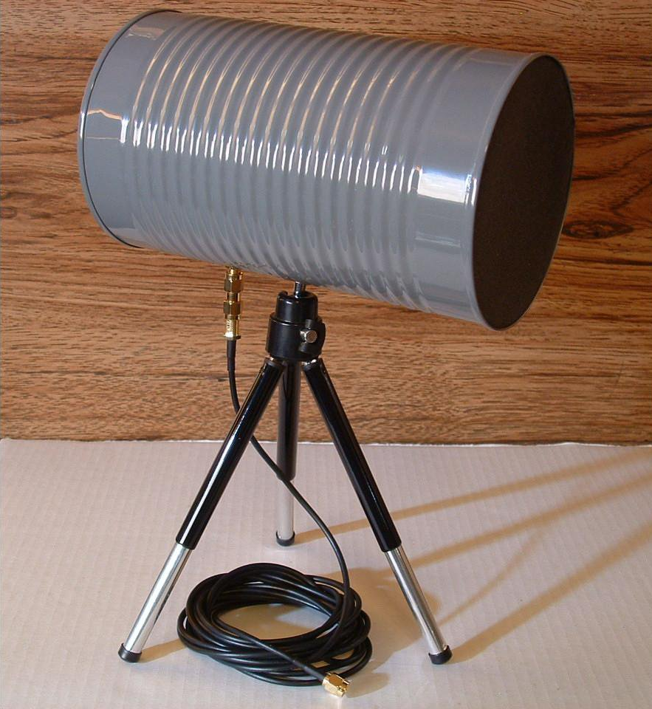
Cantennae

Slide 19
Perhaps more practical and easier to buy off the shelf is something
Like this?

Slide 20
Software for interferometry
ezRA Suite
Radio Sky Pipe
SDR Sharp with IFAverage Plug in for data collection

Slide 21
For folks starting to explore radio astronomy, ezRA - Easy Radio Astronomy Free 1420 MHz Galactic hydrogen data collection and analysis https://github.com/tedcline/ezRA Windows and Linux

Slide 22
Additive interferometry

Slide 23
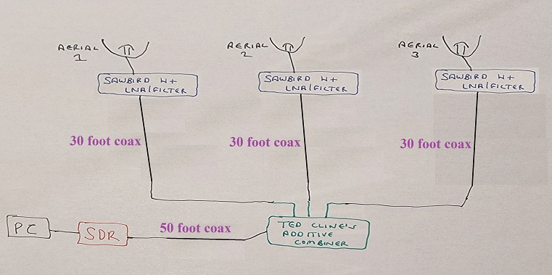
Photo/Diagram by Ted Cline

Slide 24
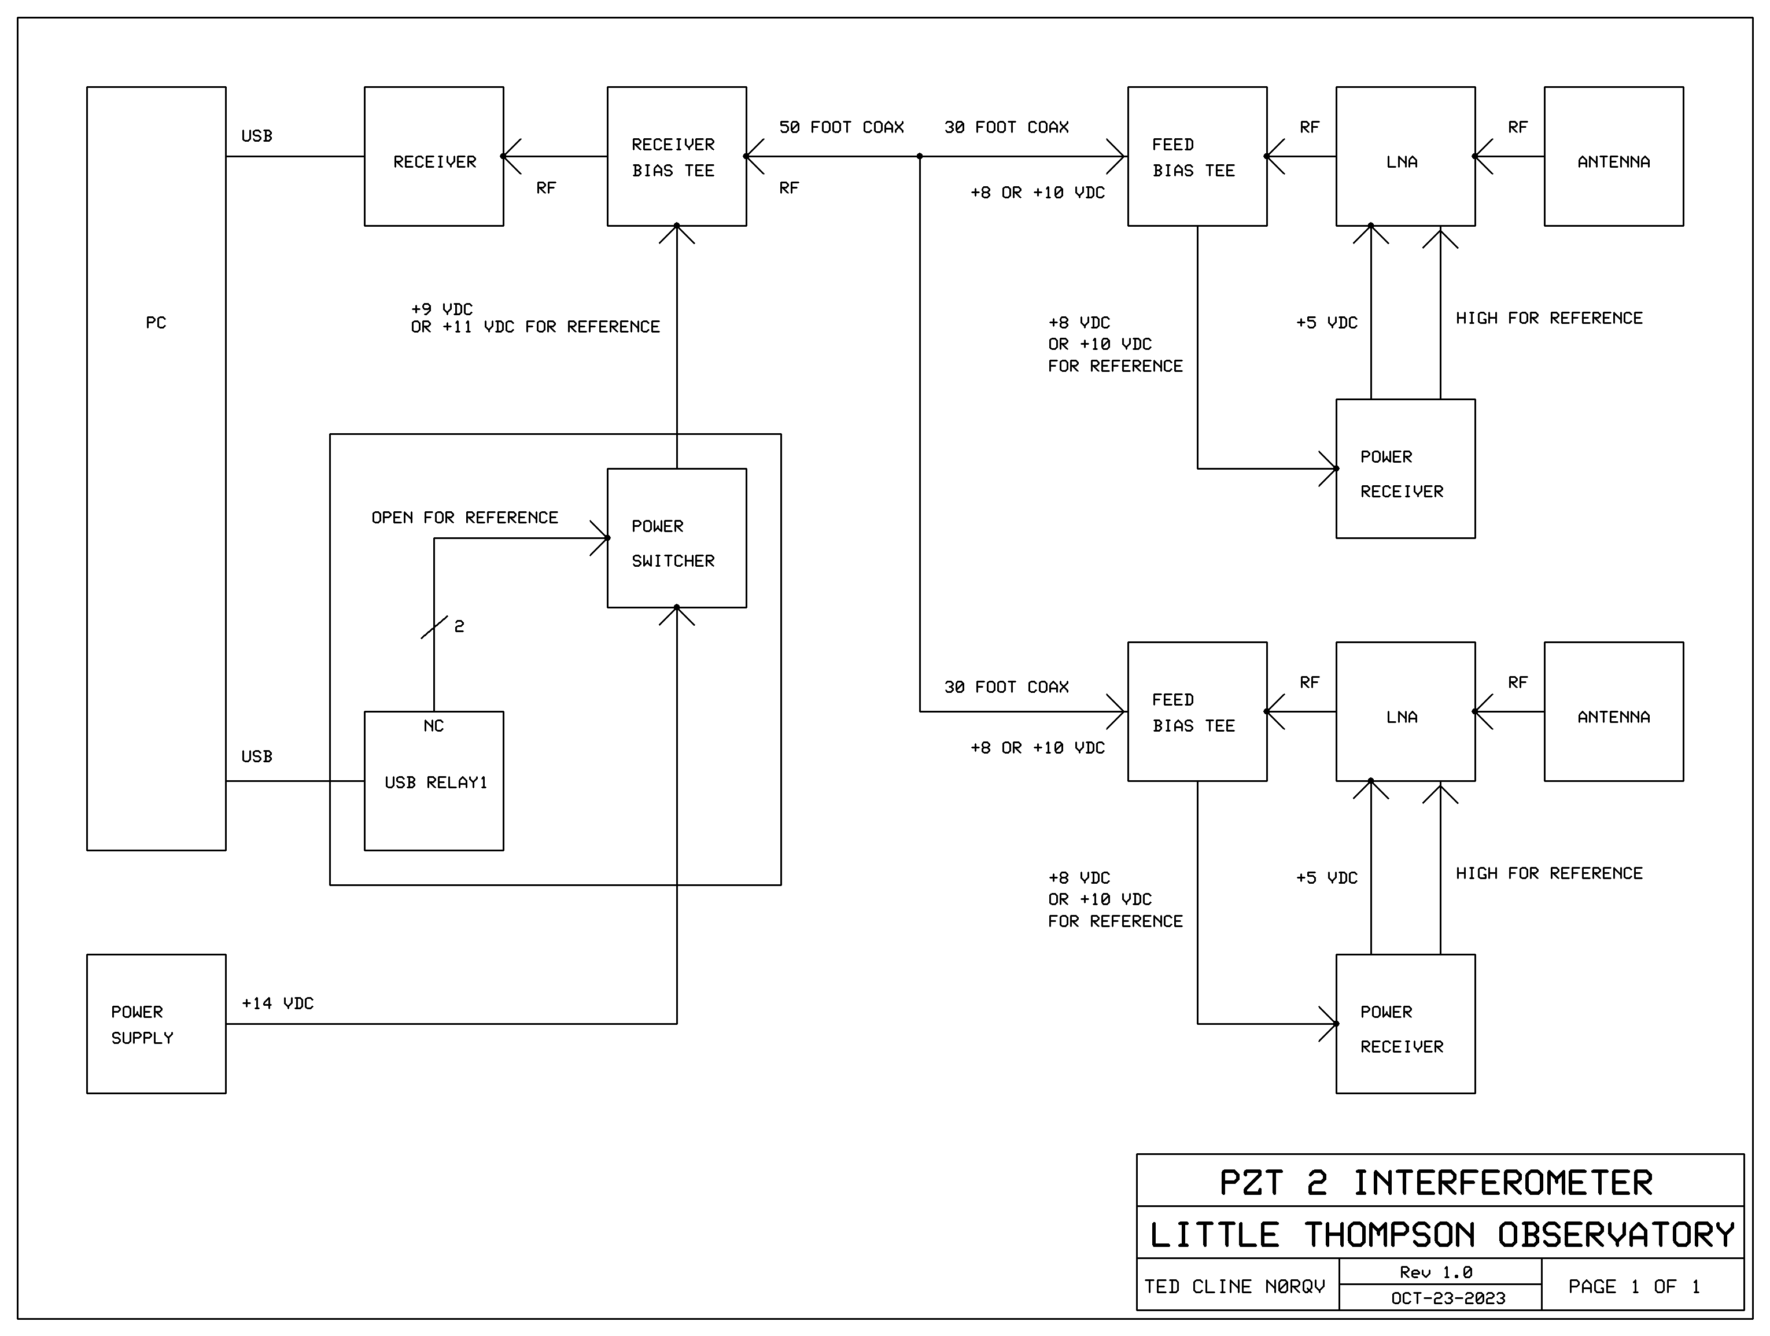
Photo/Diagram by Ted Cline

Slide 25
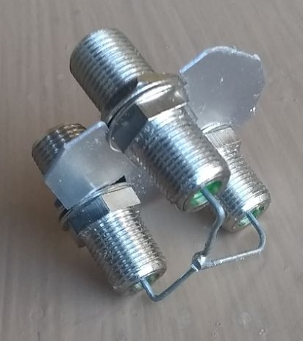
Photo/Diagram by Ted Cline

Slide 26
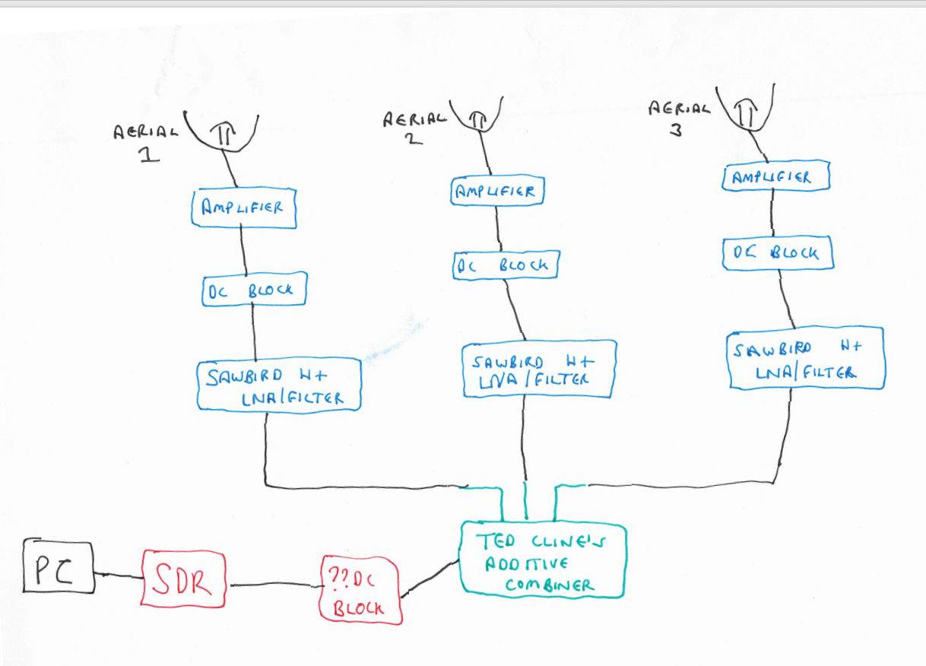
Schematic Ted Cline’s Additive Inter- ferometer

Slide 27
Examples of additive interferometry from Ted Cline
Analyse it with ezRA!

Slide 28
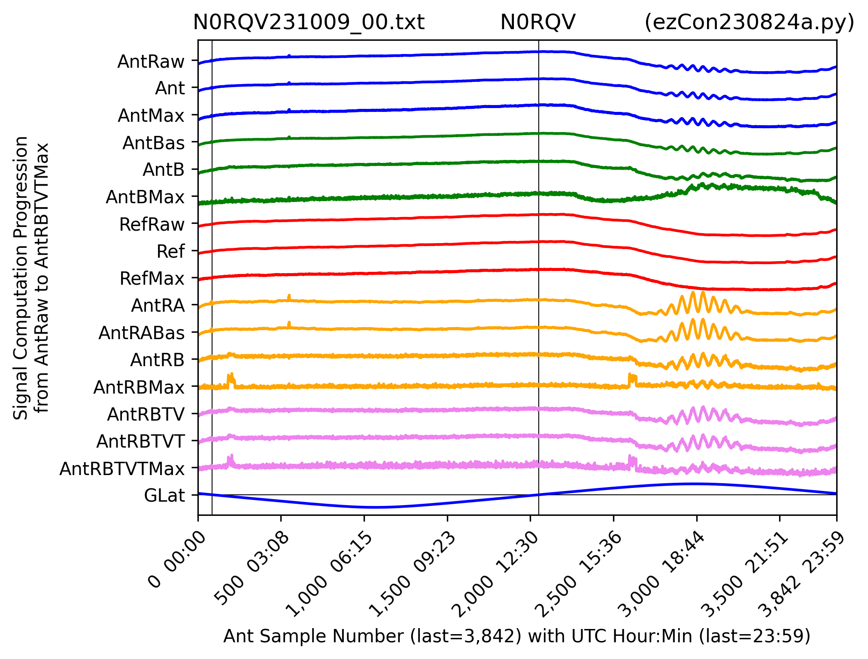
Results from Ted Cline’s Additive Interferometer
Drift scan of Sun
Photo/Diagram by Jan Lustrup

Slide 29
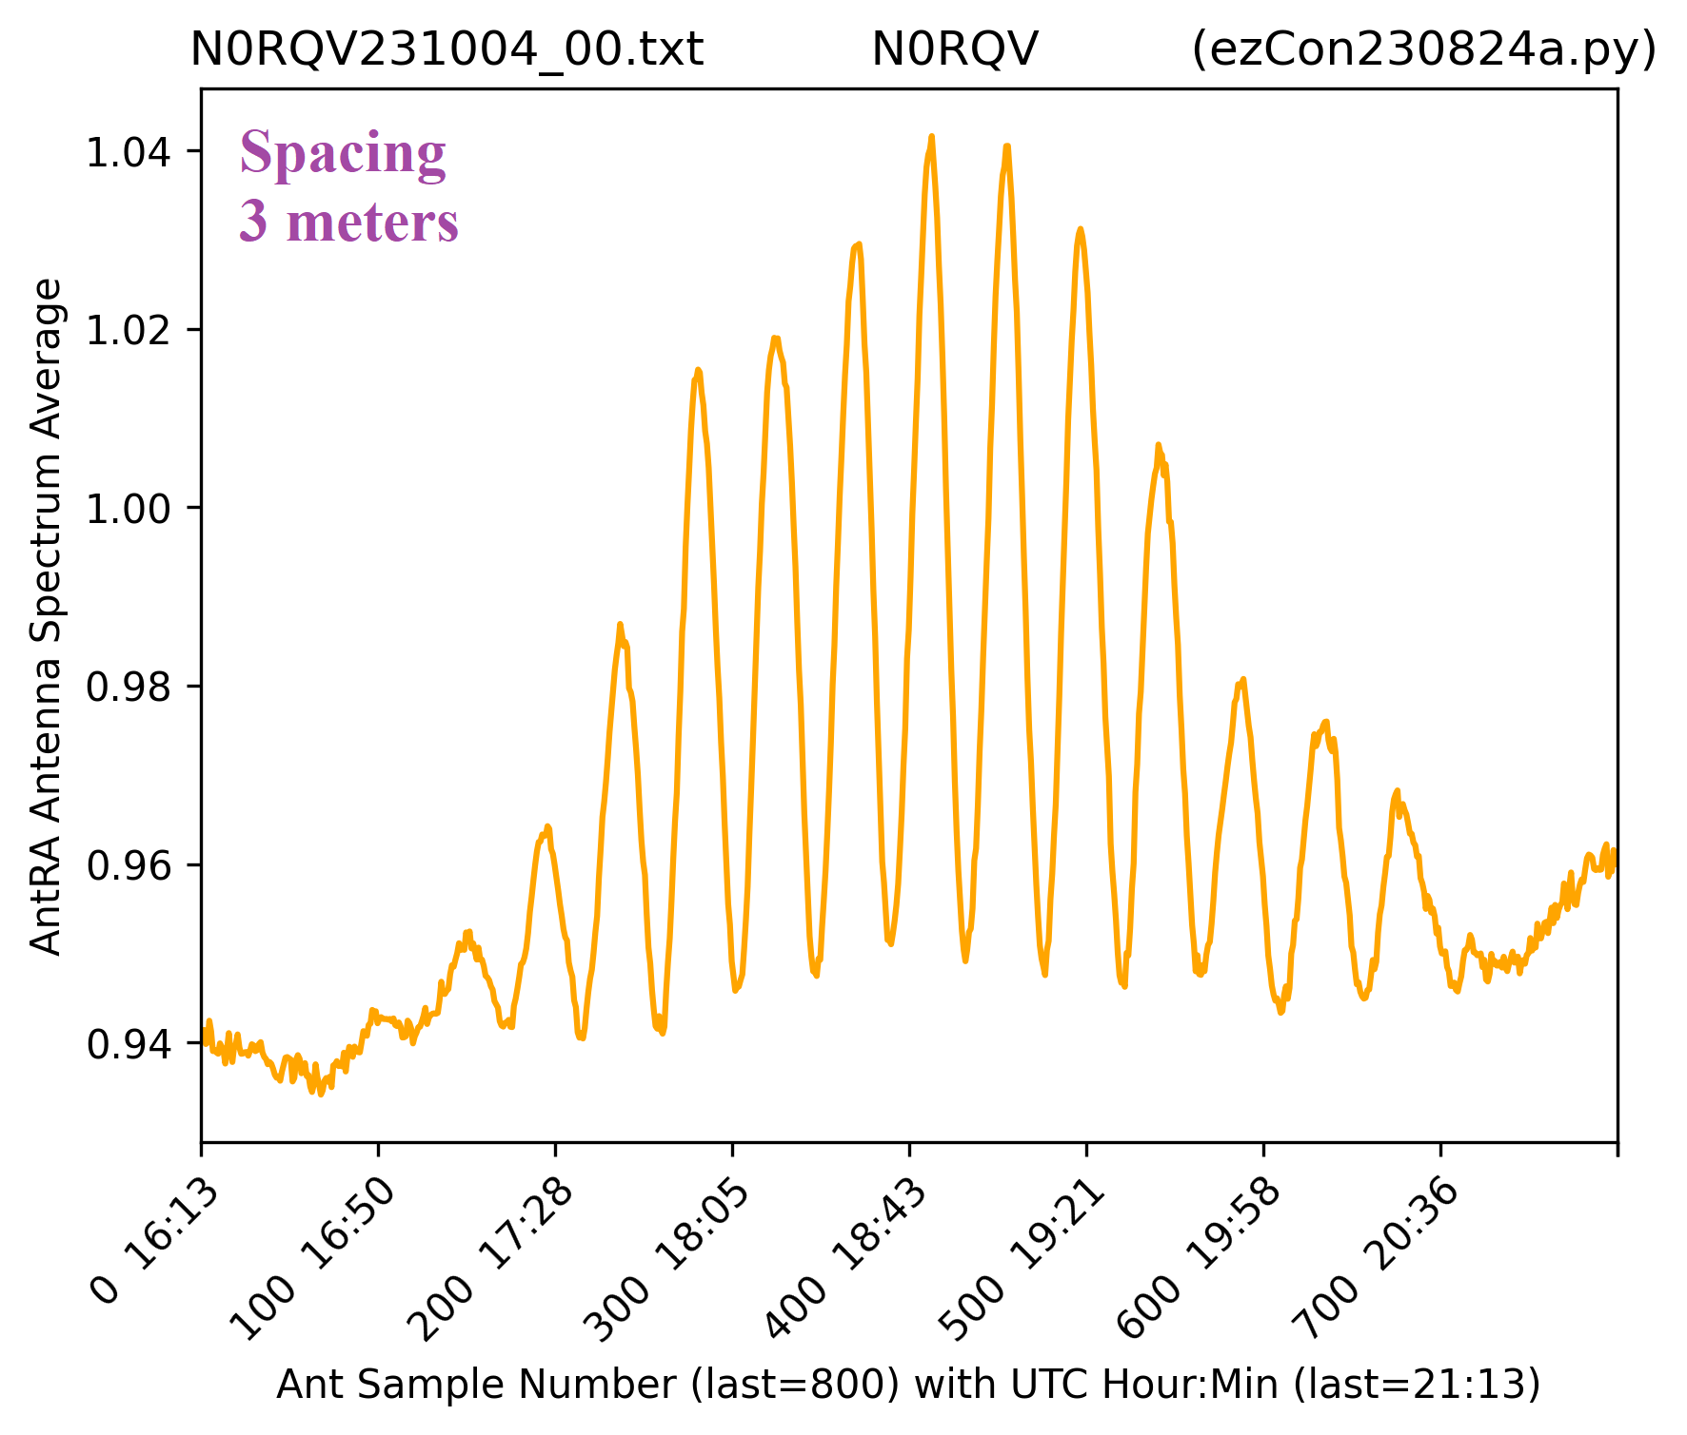
Drift scan of Sun
Photo/Diagram by Jan Lustrup

Slide 30
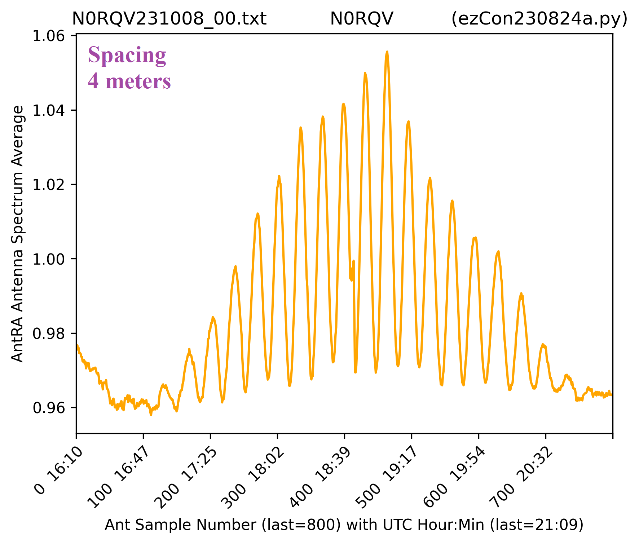
Drift scan of Sun
Photo/Diagram by Jan Lustrup

Slide 31
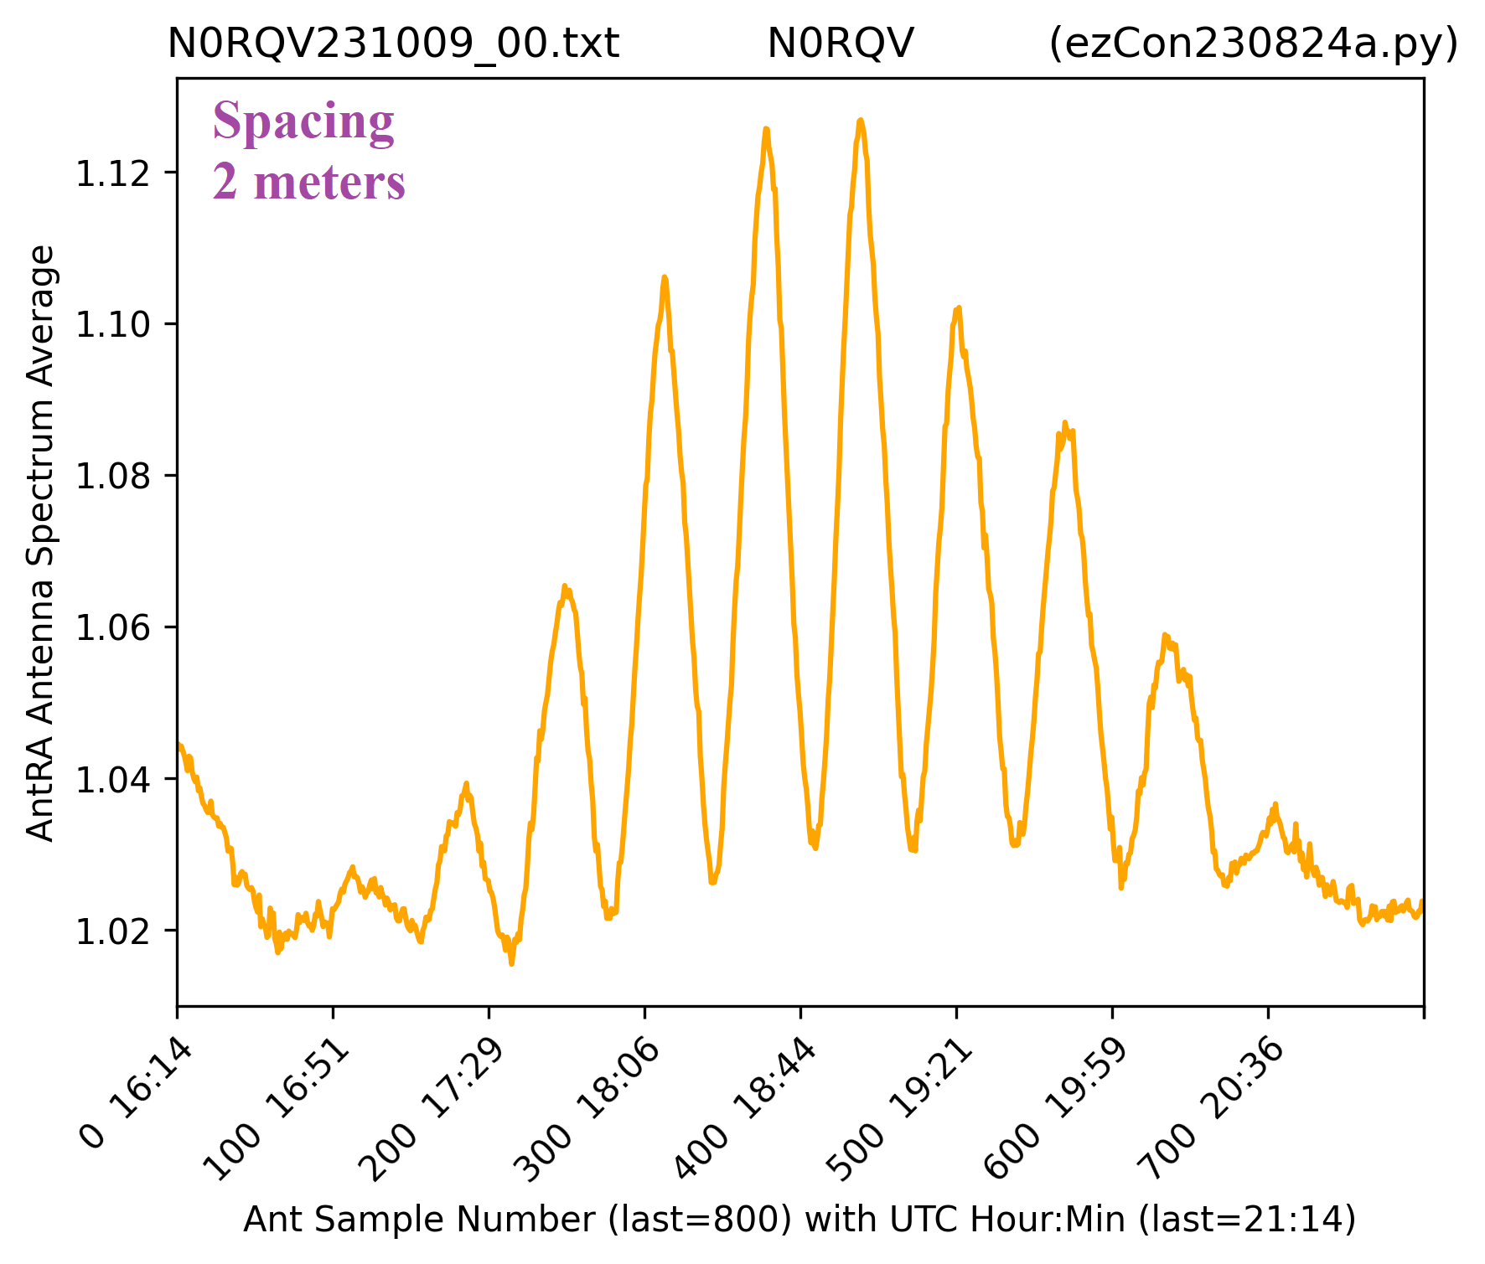
Drift scan of Sun
Photo/Diagram by Jan Lustrup

Slide 32
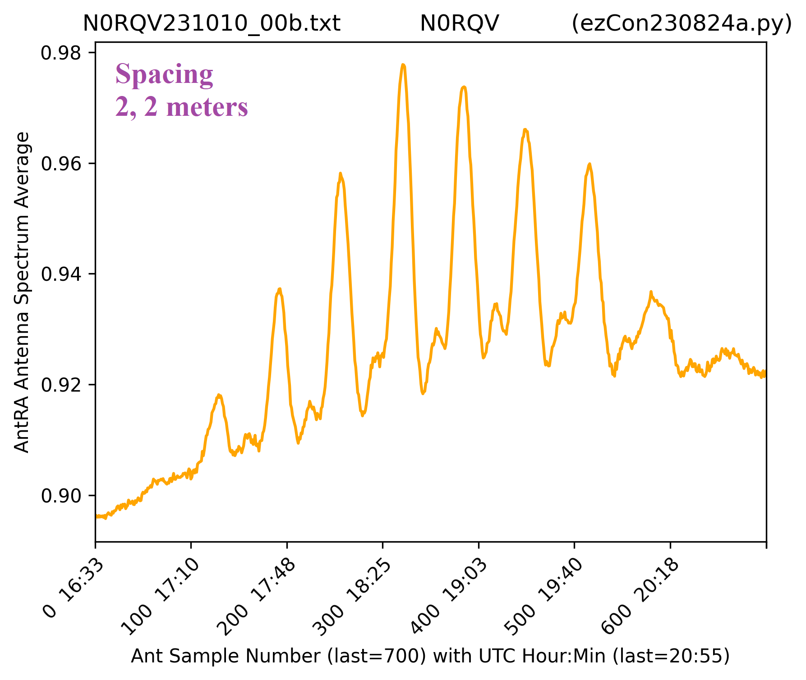
Drift scan of Sun
Photo/Diagram by Jan Lustrup

Slide 33
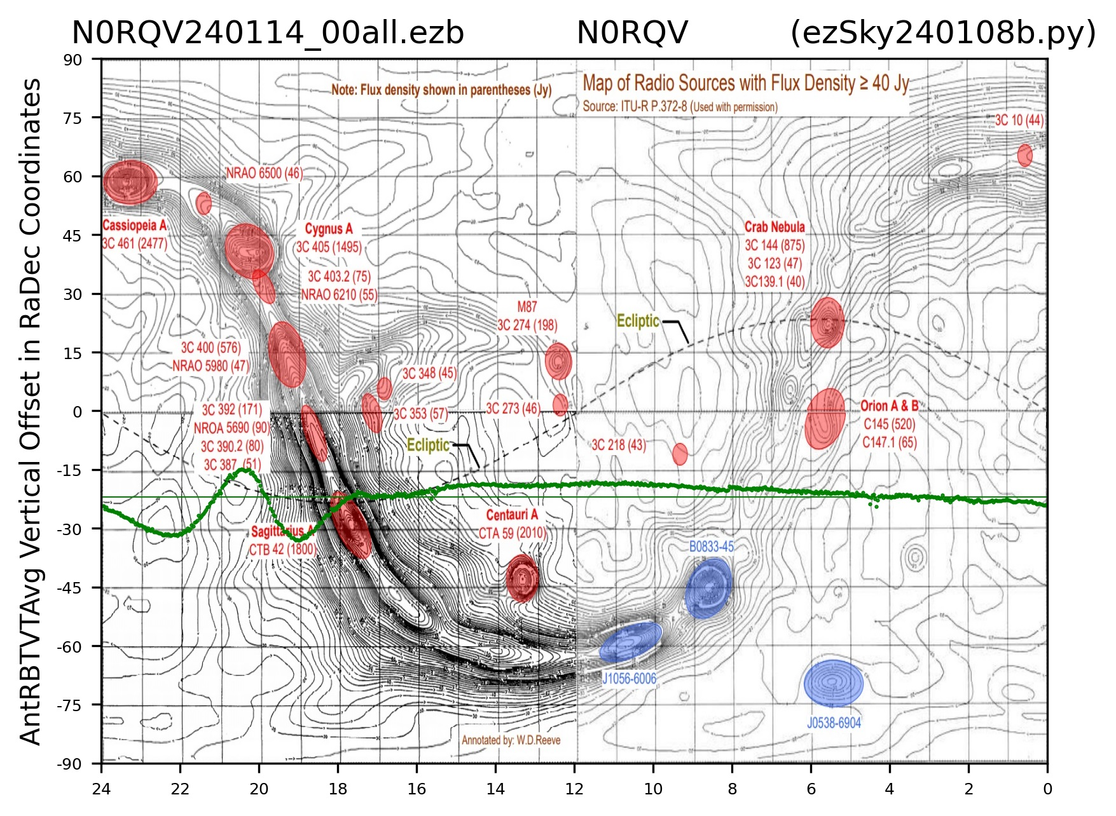
Drift scan of Sun
Photo/Diagram by Jan Lustrup

Slide 34
Multiplying interferometry using AD8302

Slide 35
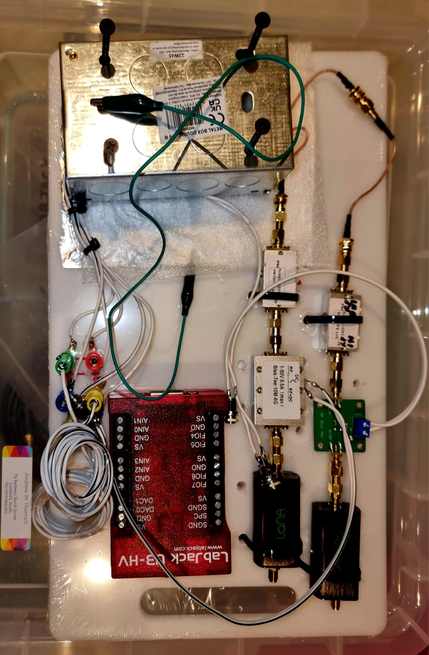
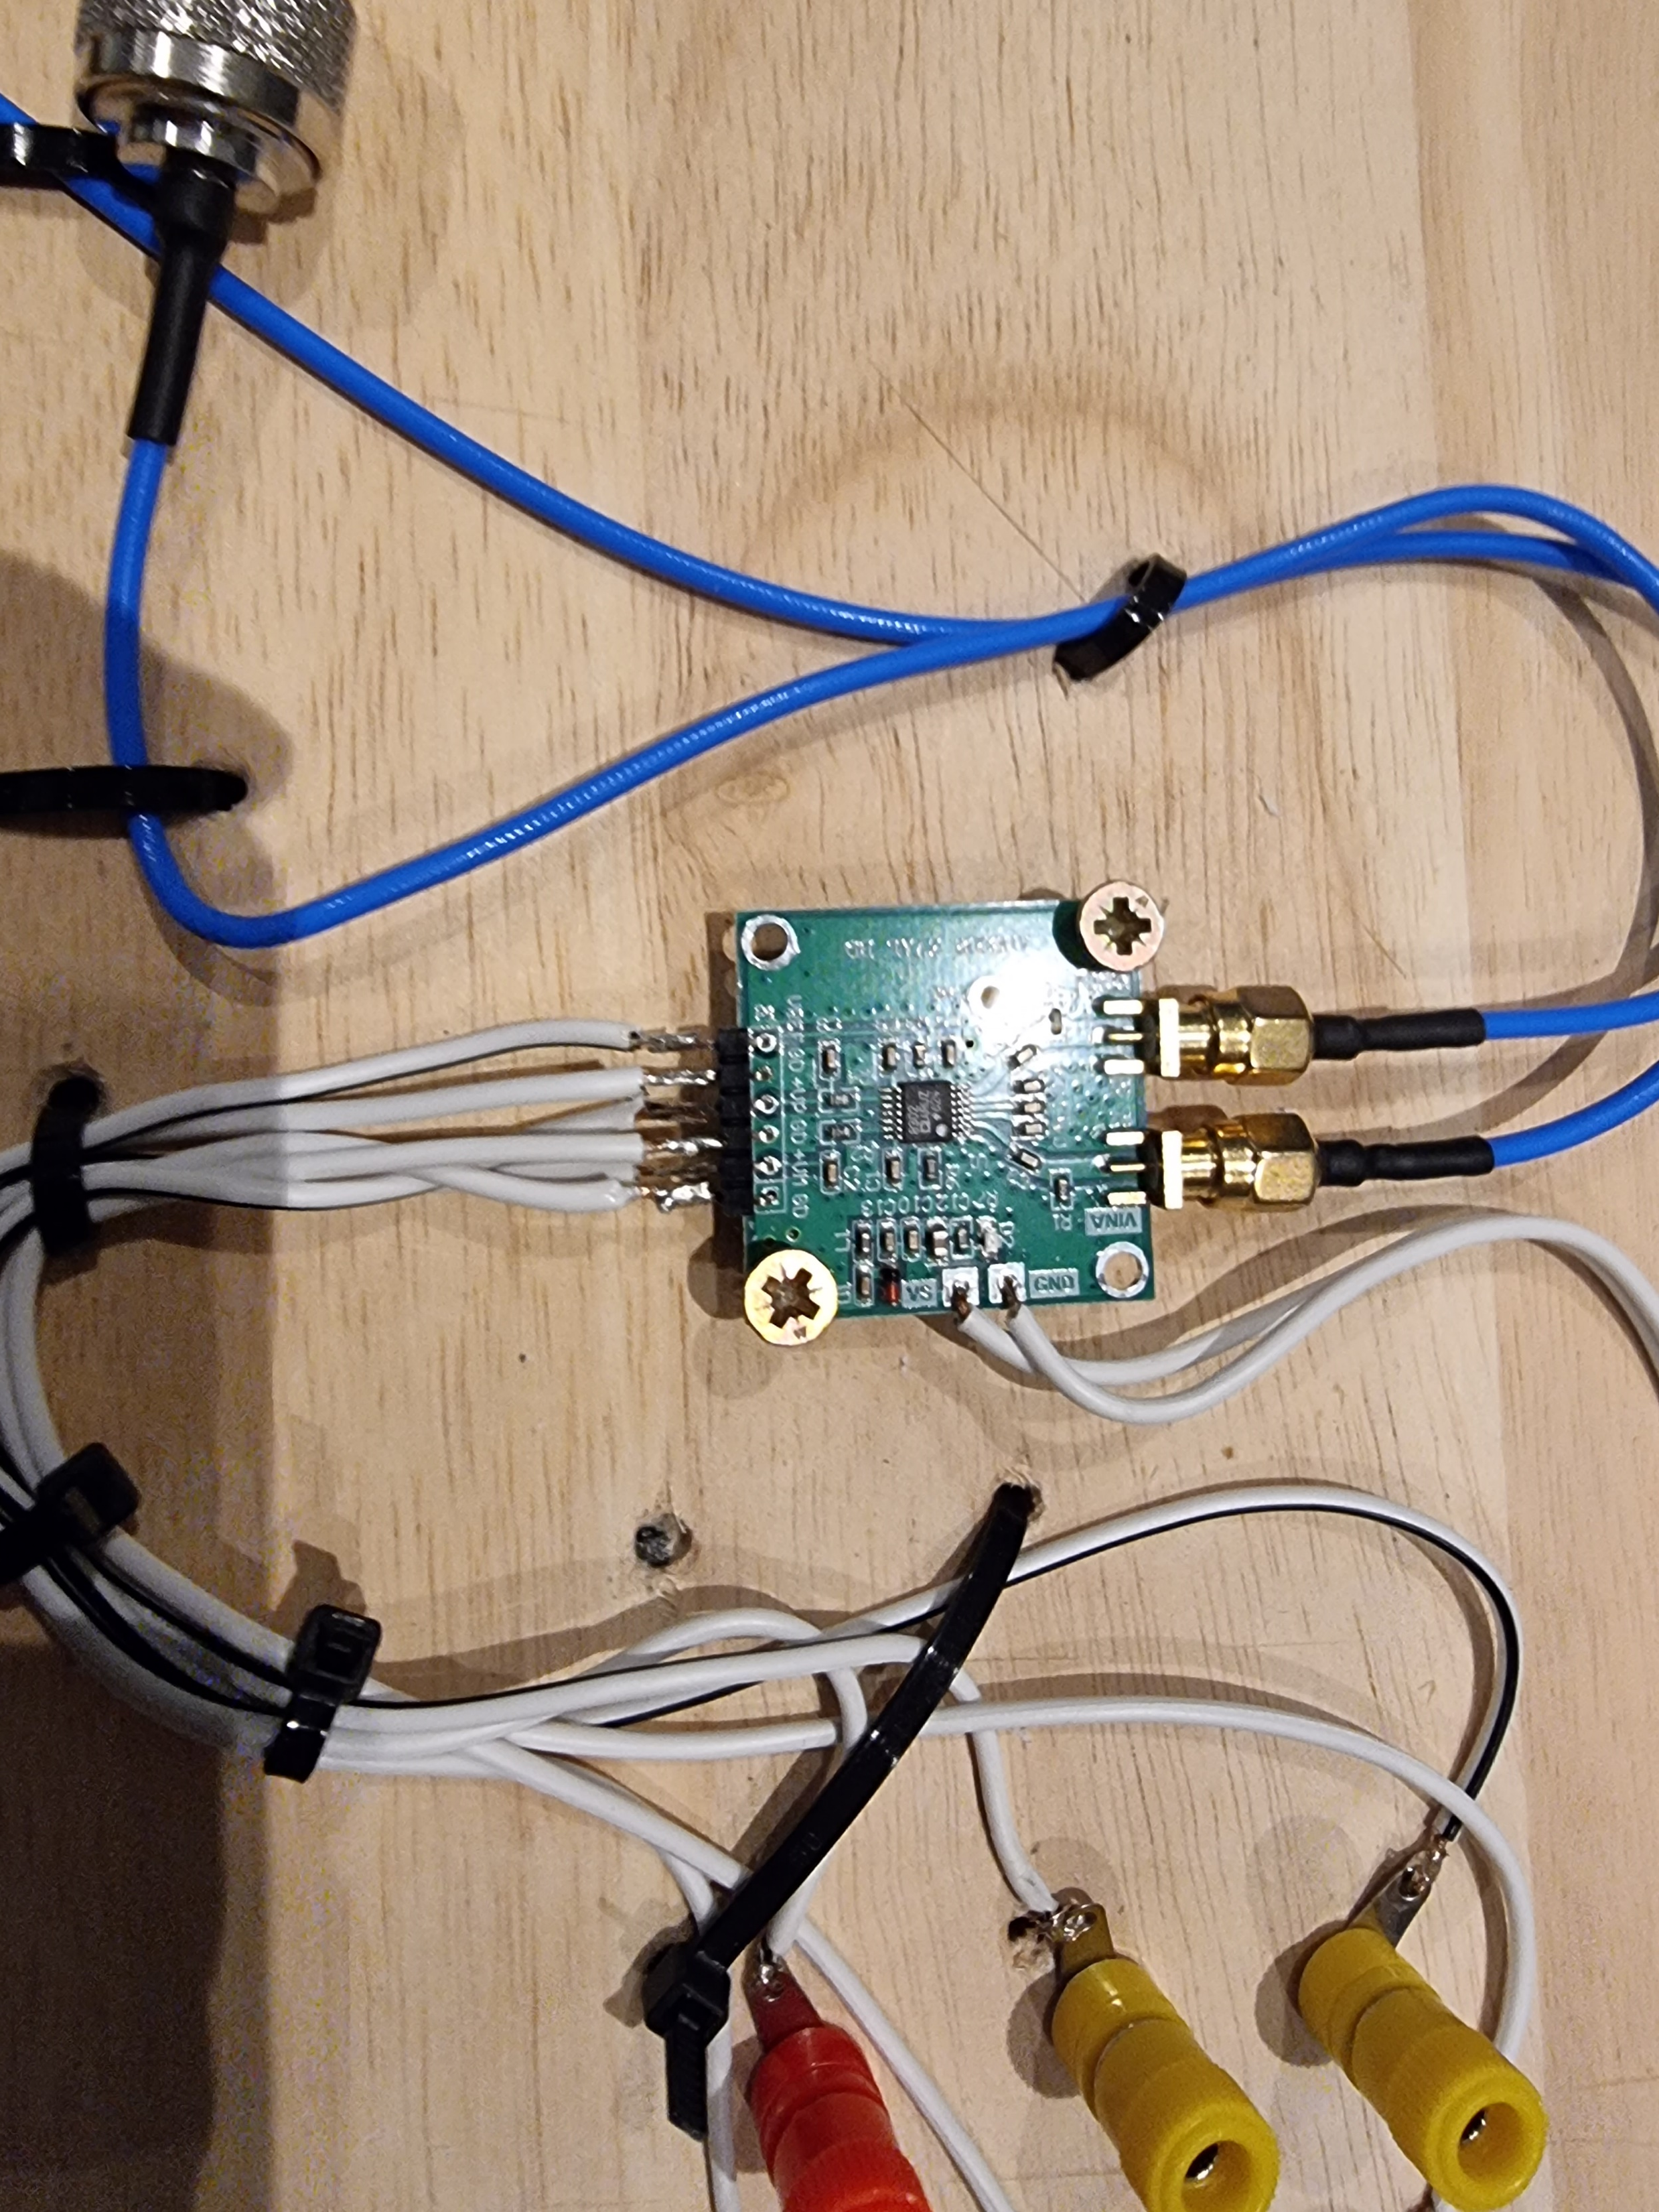
The AD8302 Amplitude Phase RF Detector
….and a
Labjack U3
Detecting the hydrogen line

Slide 36
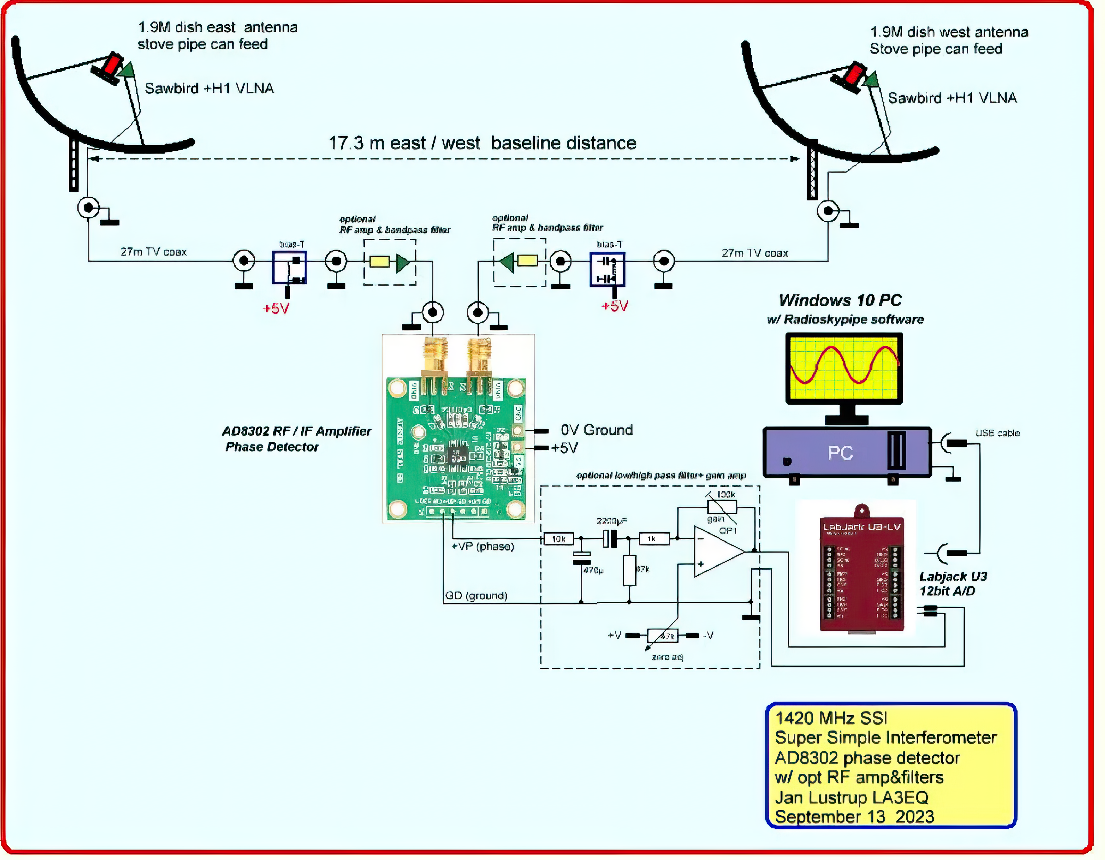
Jan Lustrup’s Schematic AD8302-based interfer-ometer

Slide 37
Amplification circuit for output of AD8302 Jan Lustrup

Slide 38
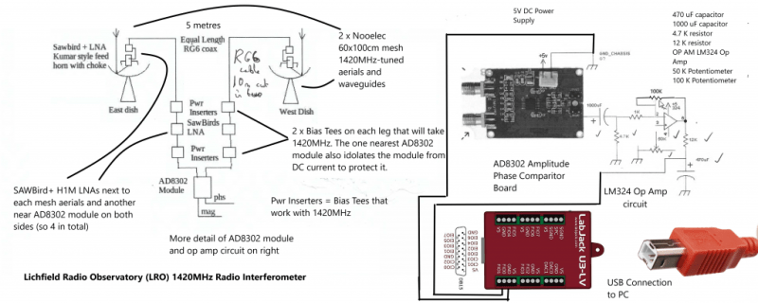
Schematic LRO AD8302-Based Interferometer

Slide 39
Layout of AD8302 receiver

Slide 40
Separation of aerials

Slide 41
Need for SAWBirds

Slide 42
Example multiplying interferometry data display with RSPII
Sun/brightest objects

Slide 43
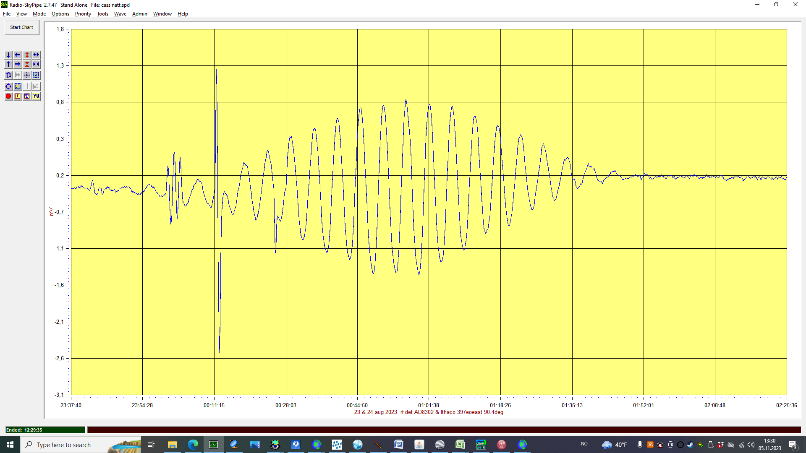
Cassiopeia A
Photo/Diagram by Jan Lustrup

Slide 44
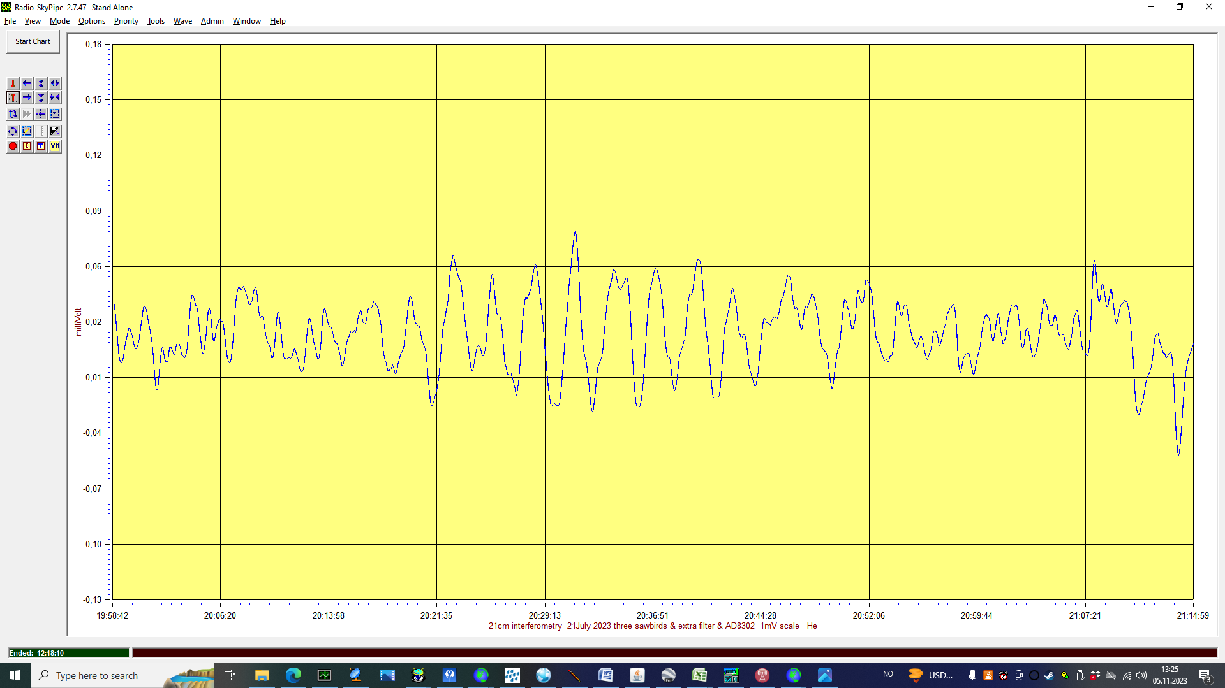
3c348 hercules.png
Photo/Diagram by Jan Lustrup

Slide 45
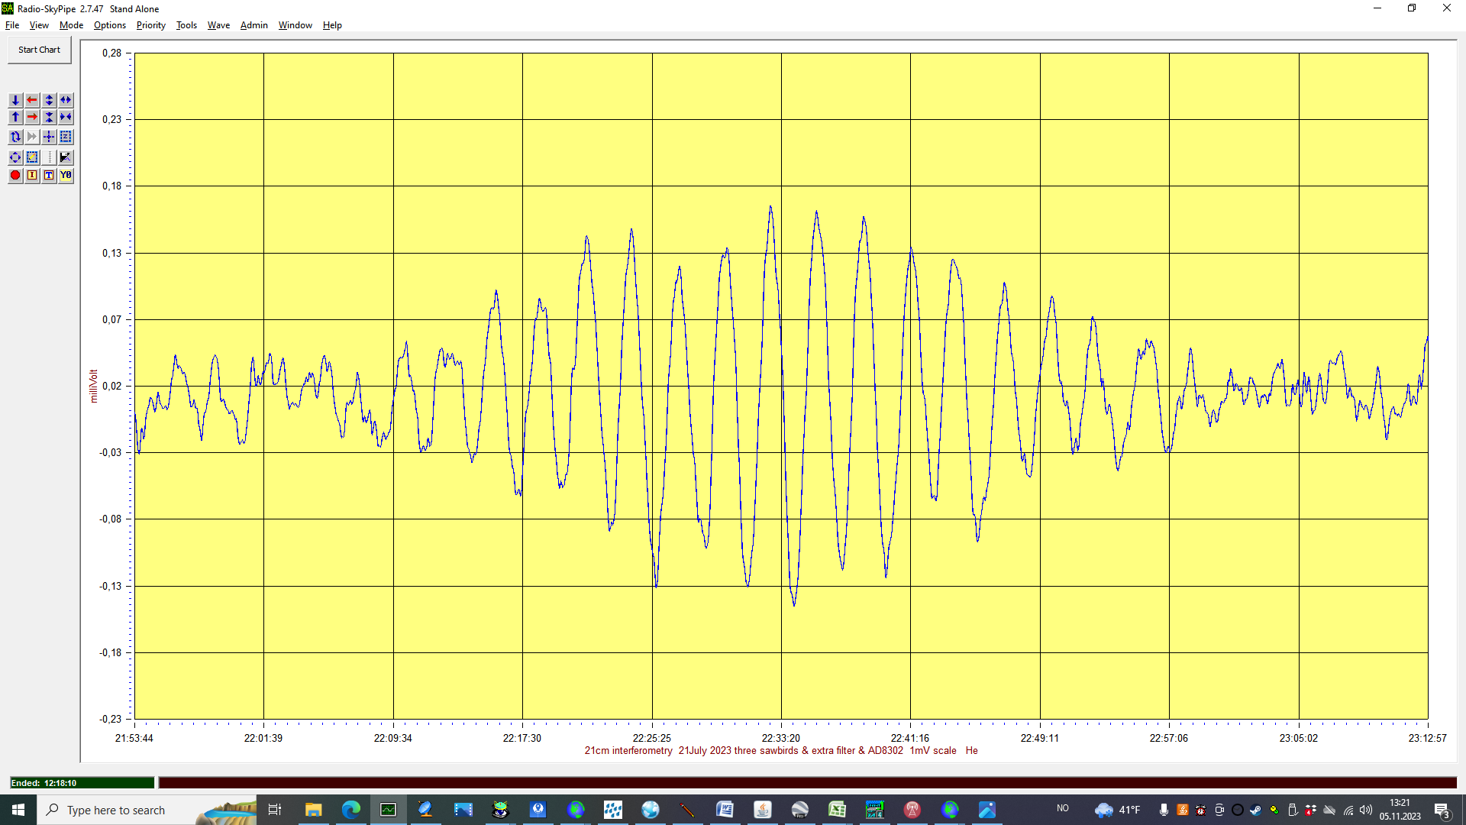
3c392.png
Photo/Diagram by Jan Lustrup

Slide 46
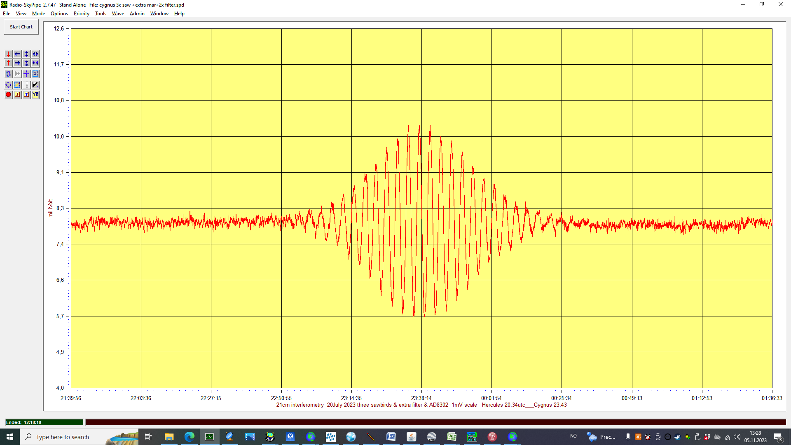
Cygnus A
Photo/Diagram by Jan Lustrup

Slide 47
Examples of Mike Otte’s data from his AD8302-based interferometer

Slide 48
Mike Otte’s schematic annotated with LRO differences

Slide 49
Mike Otte

Slide 50
Mike Otte’s 1420MHz interferometer

Slide 51
Calculations for Mike Otte’s interferometer

Slide 52
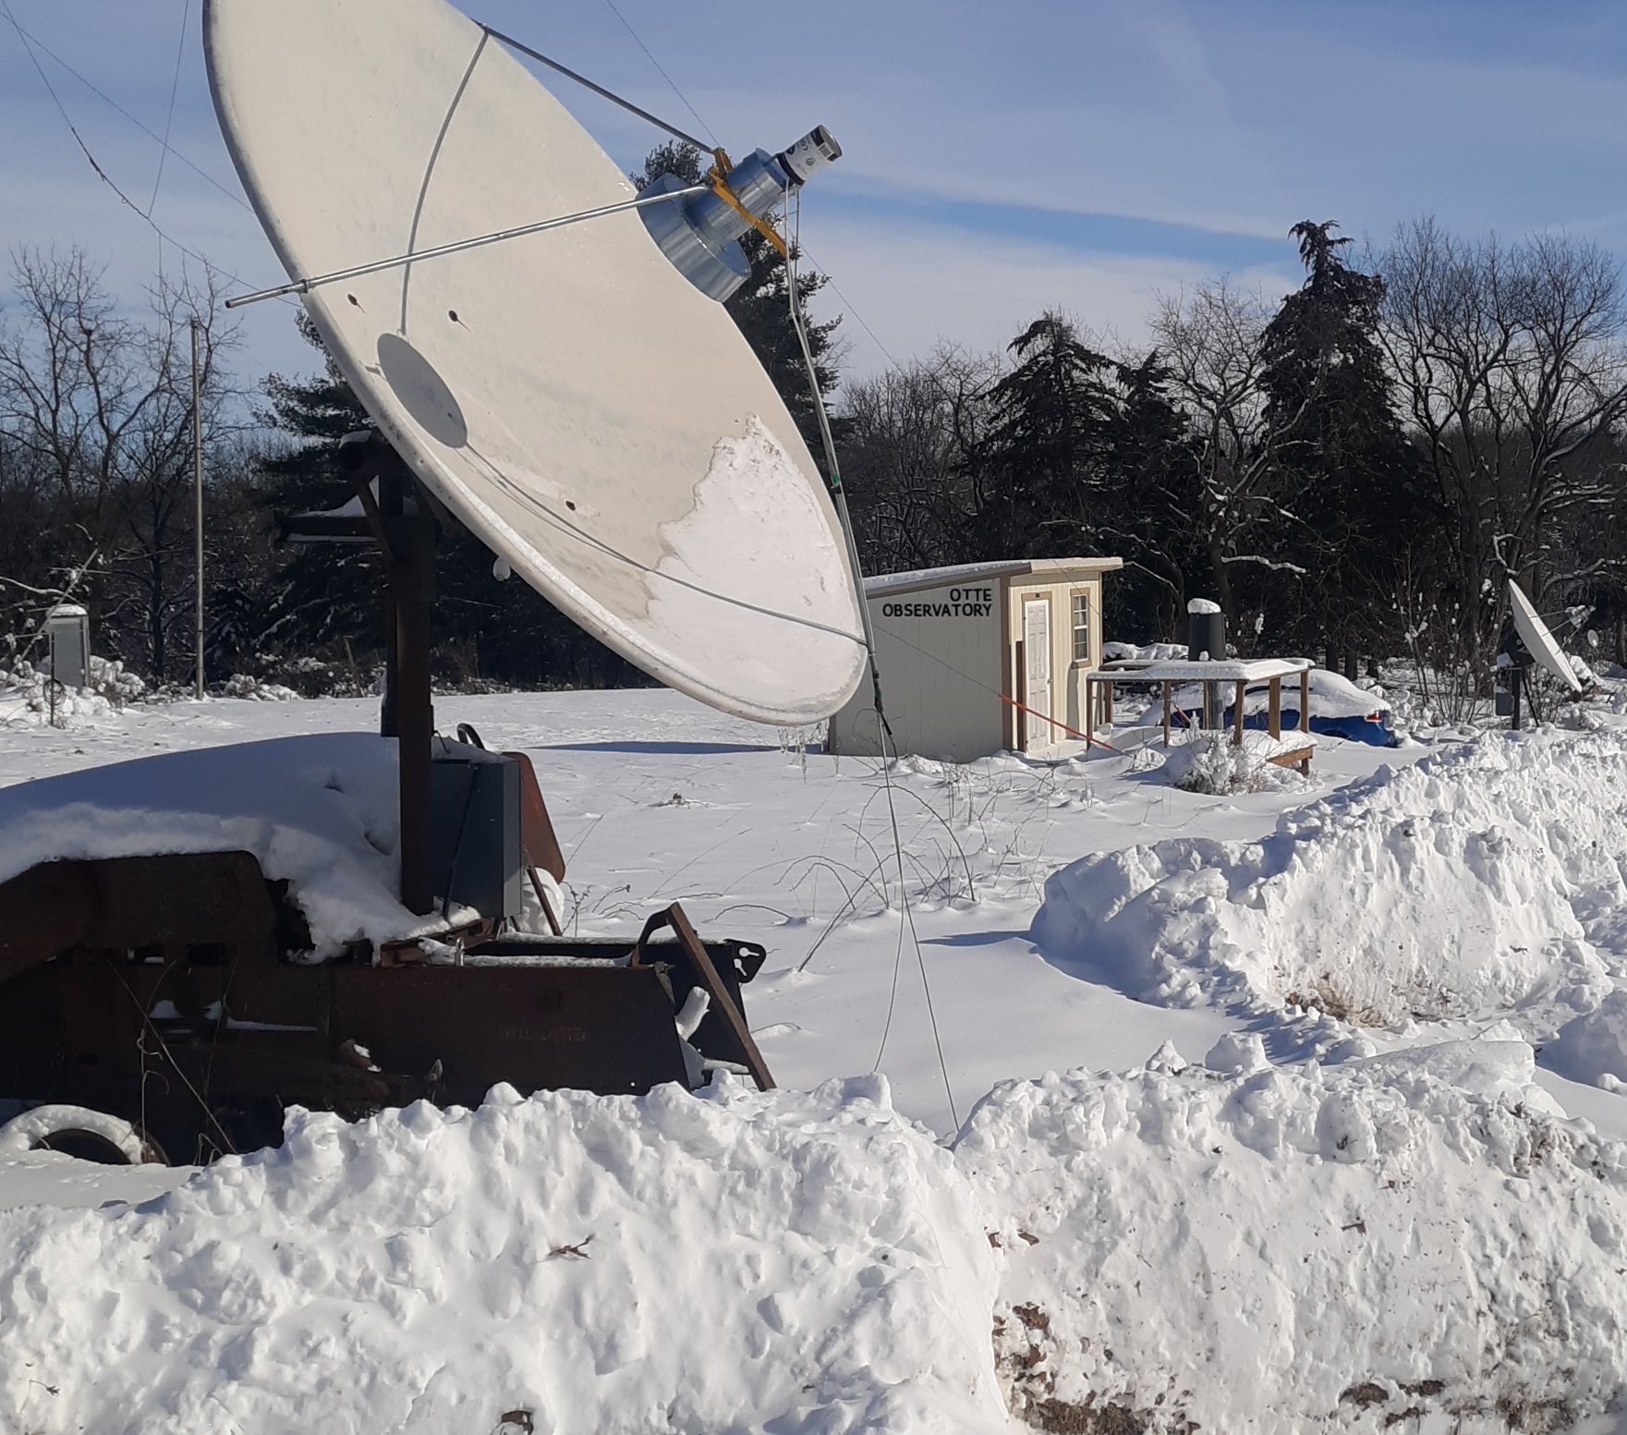
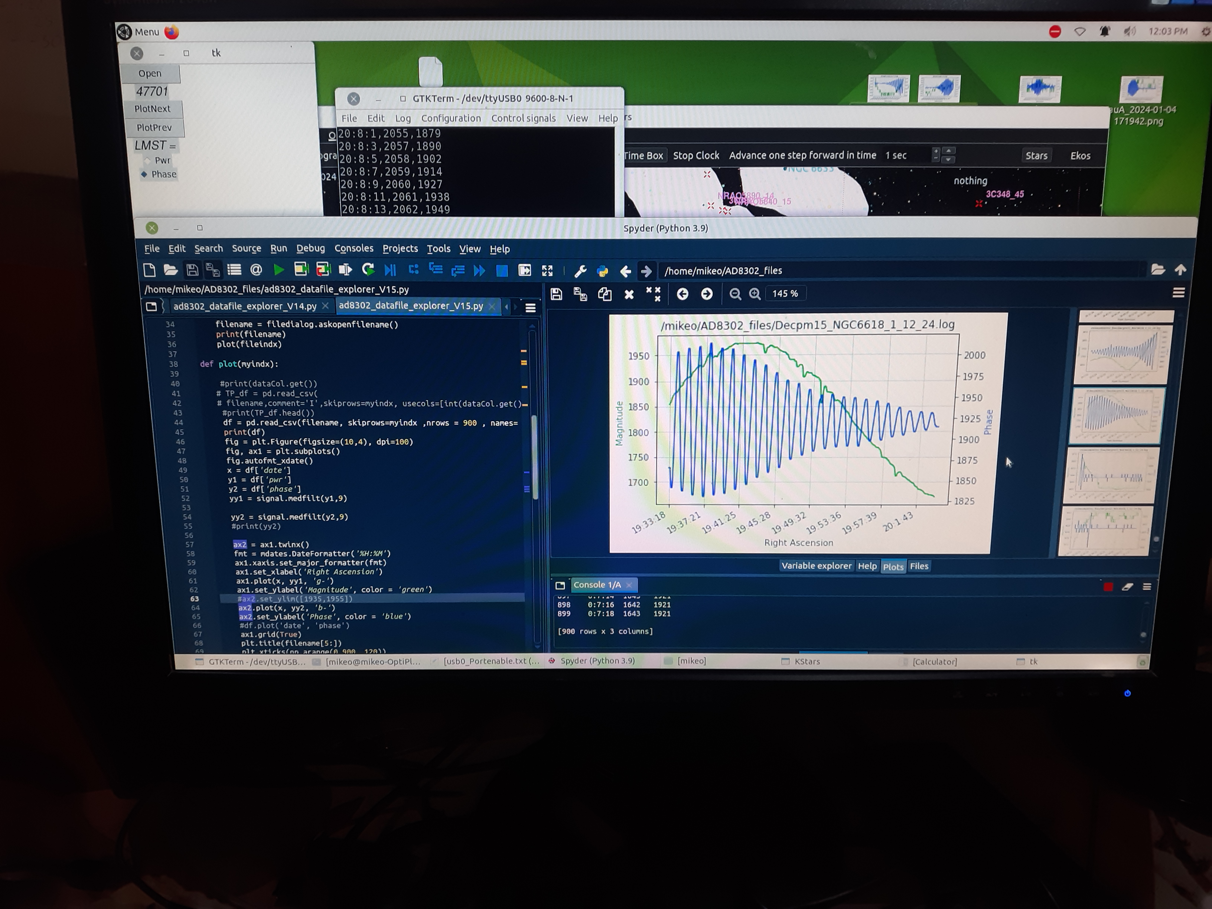
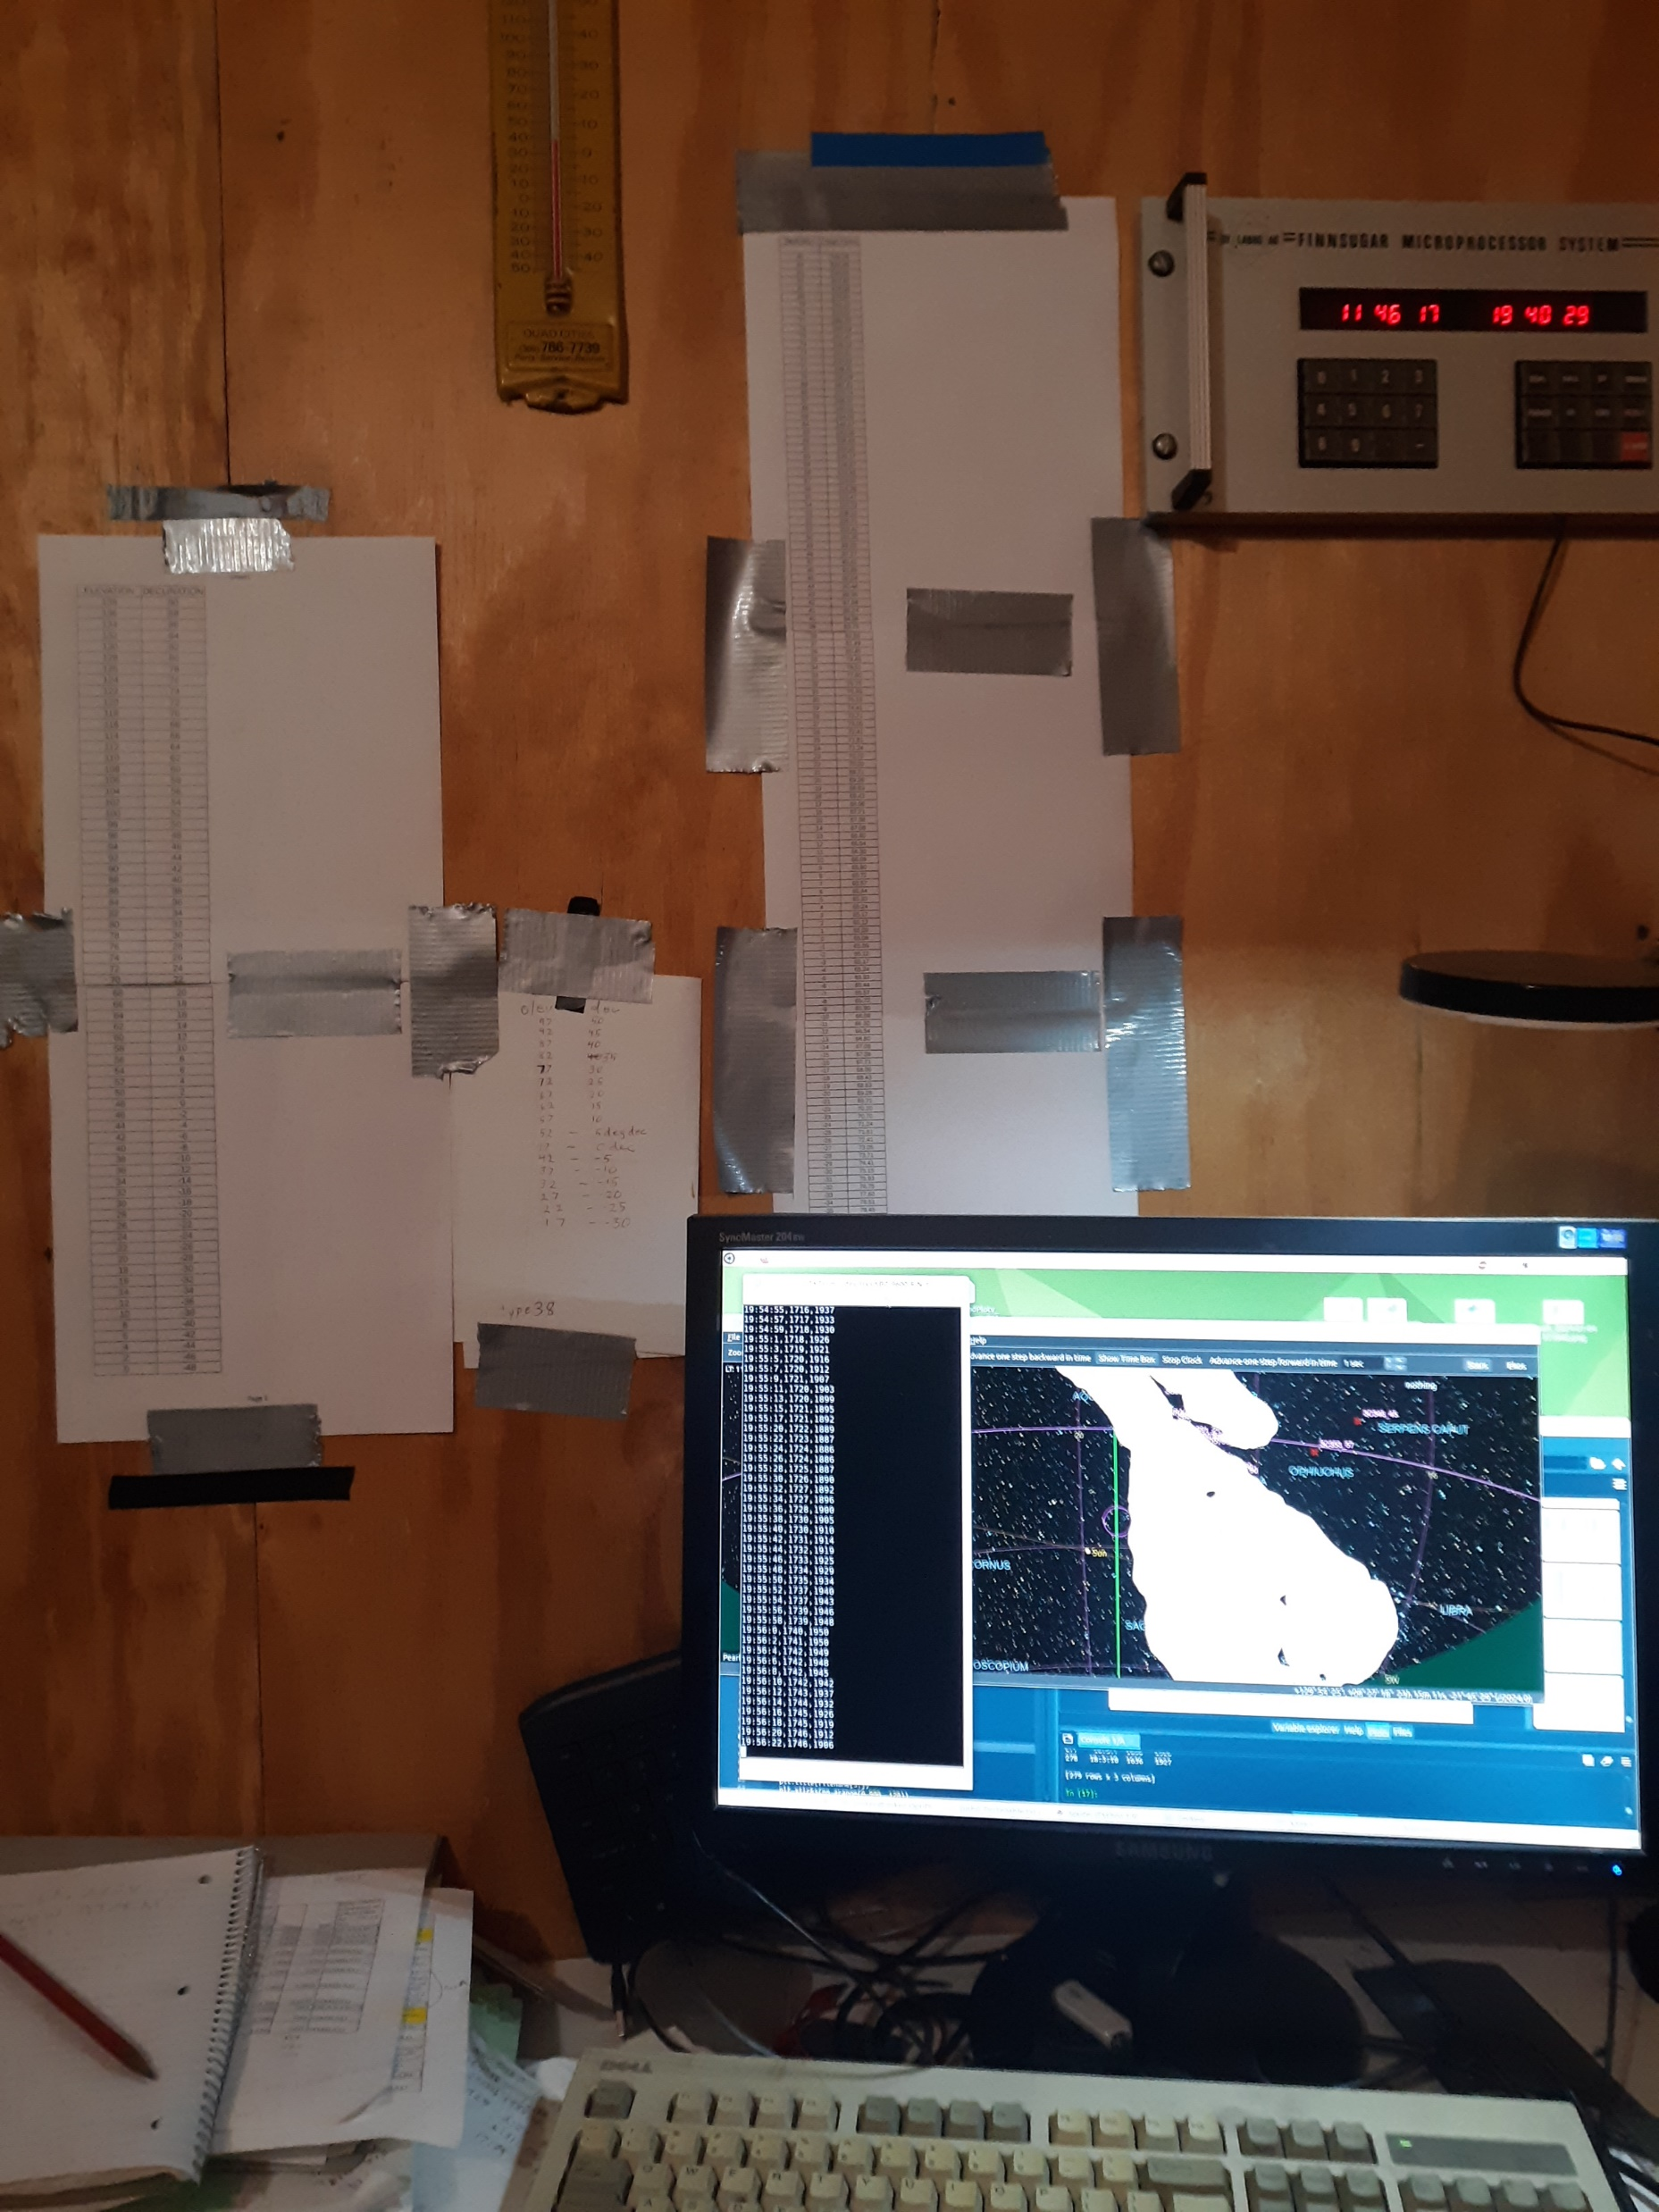
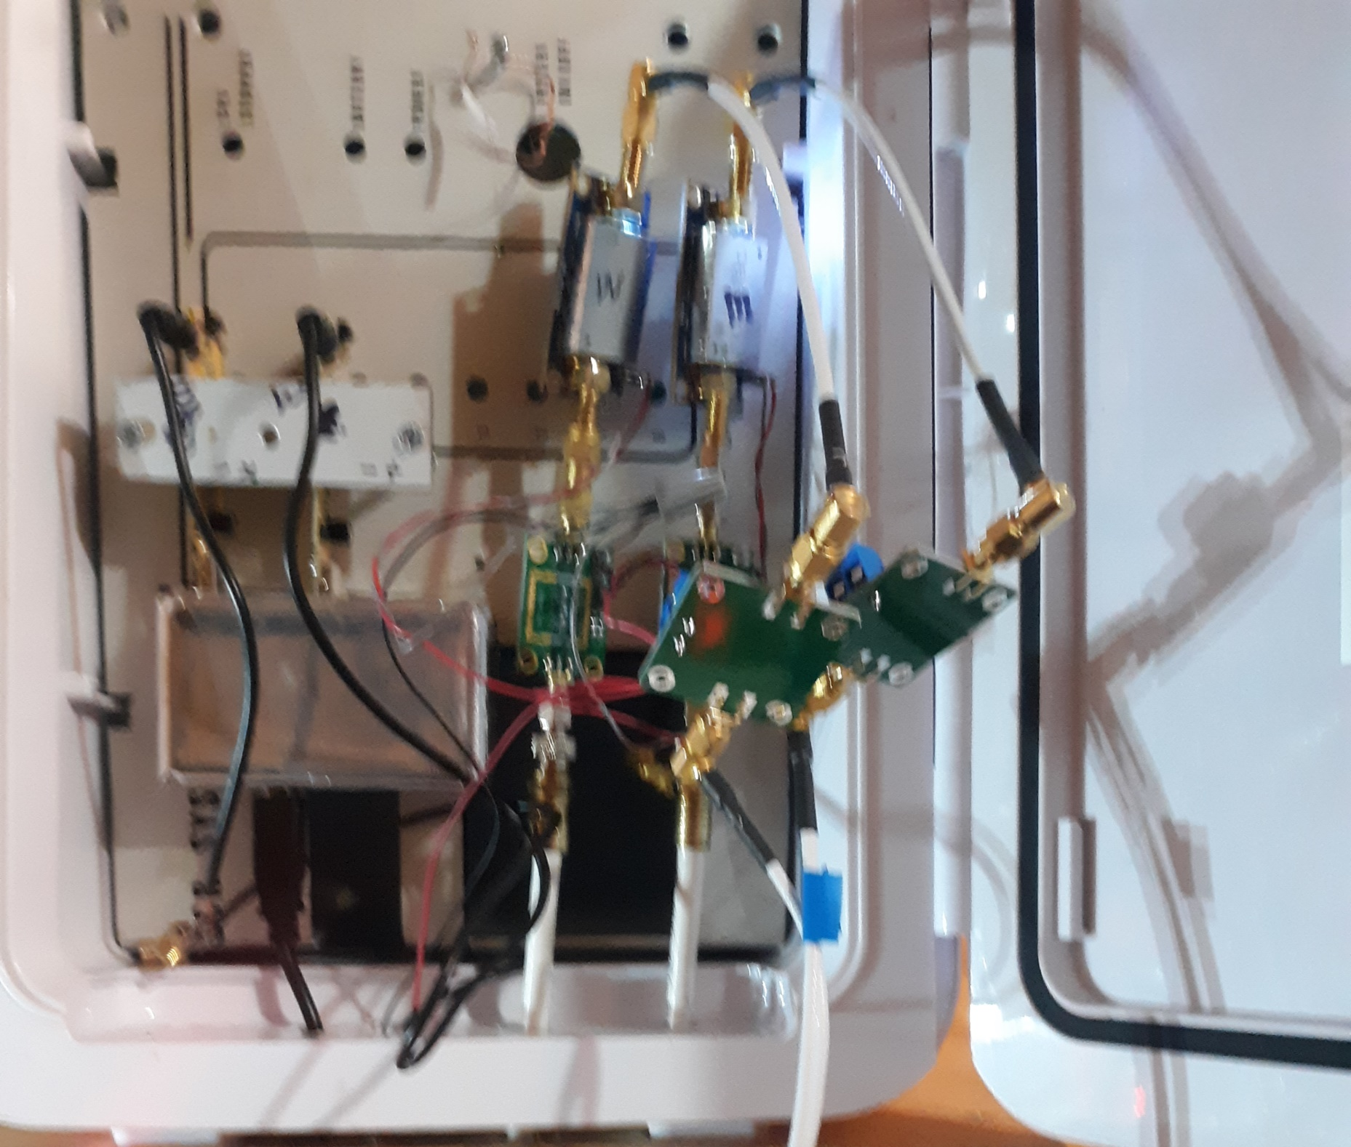
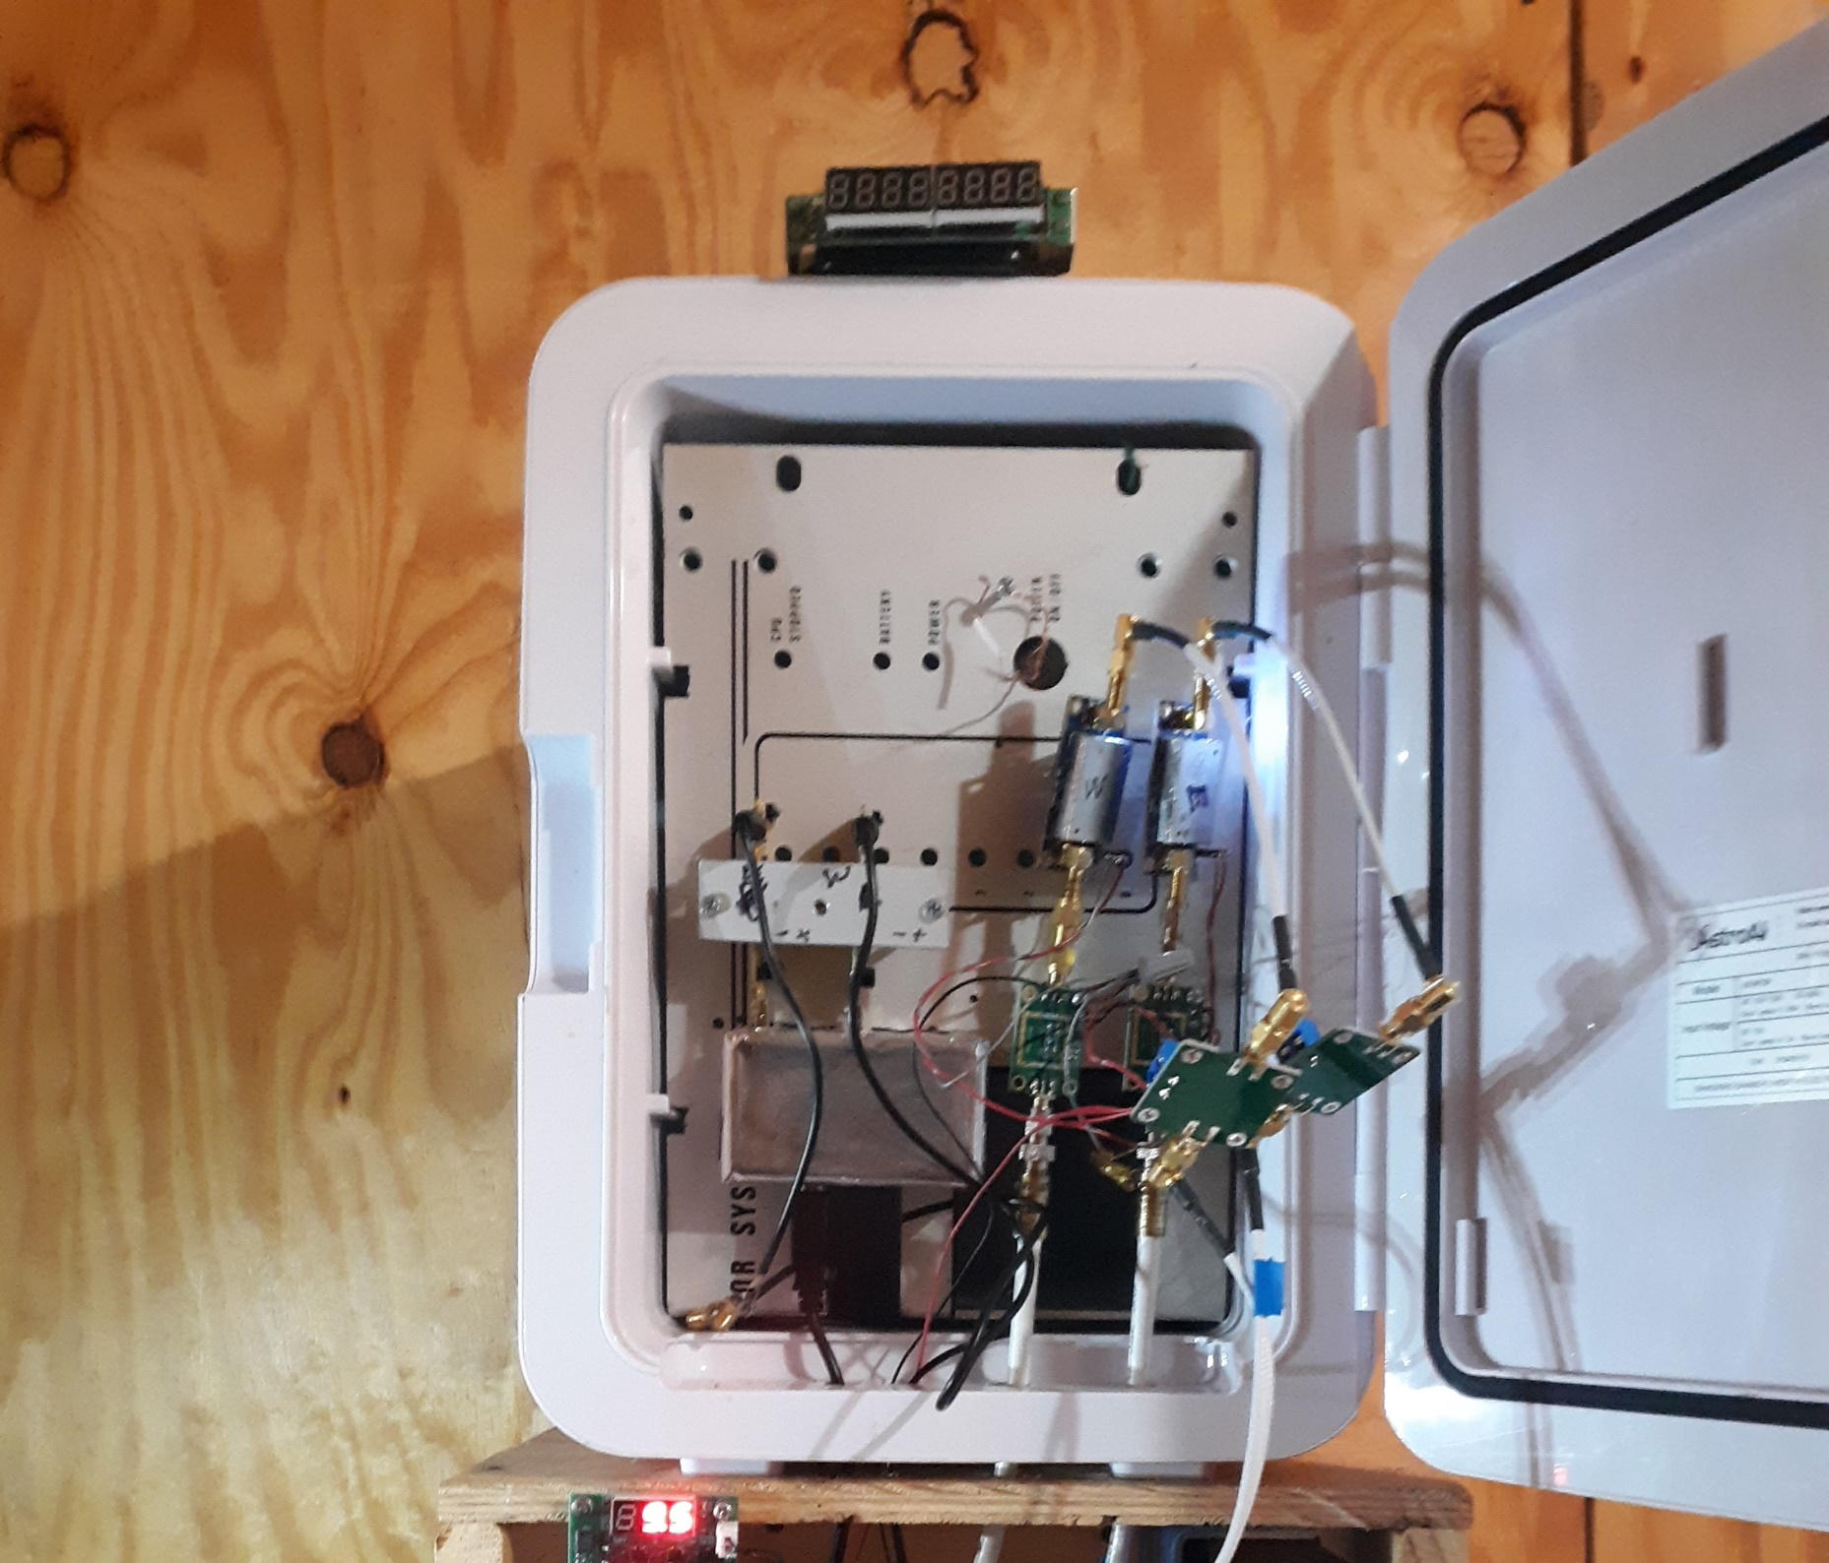
Mike Otte’s
Station

Slide 53
Interferometry at LRO

Slide 54
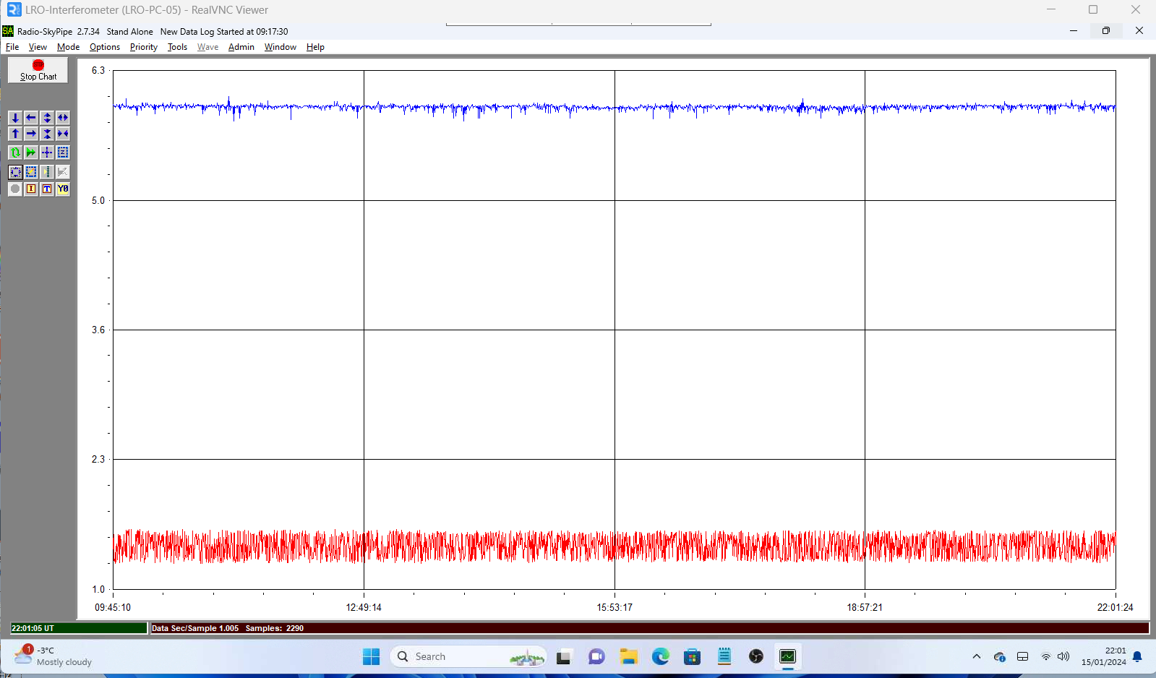
Not getting correct trace at LRO

Slide 55
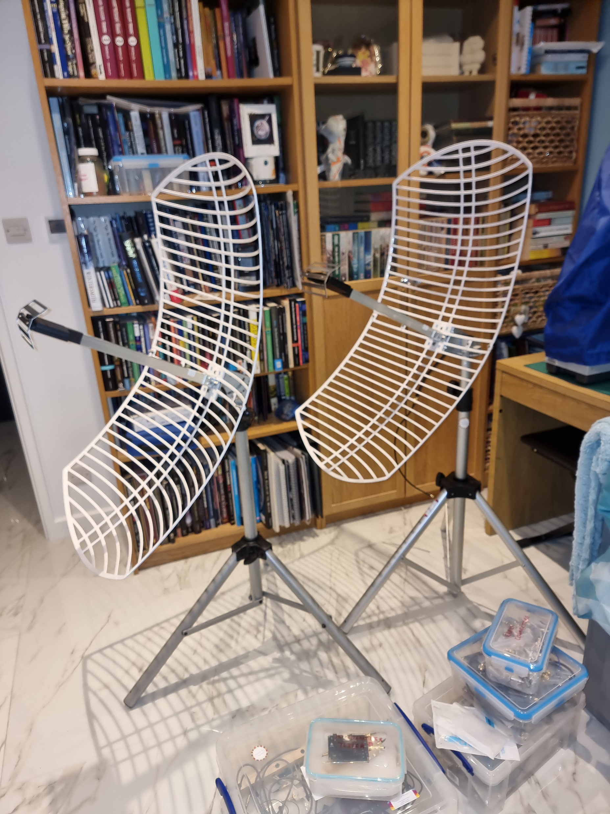
LRO
Interferometer

Slide 56
Contact info

Slide 57
Contact Details:
Dr Andrew Thornett
M6THO
andrew@thornett.net
www.astronomy.me.uk

